Slide 1
Applying Library of Congress Faceted Vocabularies
Adam L. Schiff
Principal Cataloger, University of Washington Libraries
aschiff@uw.edu
http://faculty.washington.edu/aschiff/
TBLC Catalogers Group Meeting 2018
Saint Leo University
July 12, 2018

Slide 2
Outline
LCGFT
Background and Principles
“General” Terms
Literature Terms
Artistic and Visual Works Terms
Moving Image, Music, and Cartographic Materials Terms (but I will skip due to time constraints)
LCDGT
Background and Principles
Audience Examples
Creator/Contributor Characteristics Examples
Facets and Your Discovery System

Slide 3
Background
LCSH for many decades included headings and subdivisions that were used to describe what a resource is rather than what it is about. Headings can describe numerous non-subject aspects, including:
Genre/form Symphonies World maps Comedy films Sports posters
Creator info Canadian fiction Film posters, Swiss American poetry--
Women authors African American children's writings
Music by Jewish composers
Place of origin Almanacs, Argentinian Folk music--Appalachian Region
Language Inuktitut poetry Short stories, Zambian (English)
Audience Young adult fiction Teen films Music--Dictionaries, Juvenile
Time period of creation Rock music--1961-1970 Tales, Medieval
Music medium of performance Piano quintets Concertos (Bassoon, flute, oboe)
Flutes (3) with orchestra
Notes:
I’ve used different colors to show the different aspects that are mixed in many LCSH terms and subject strings. Red indicates the genre/form aspect.

Slide 4
Background
Starting with genre/form in 2007, LC has been developing new controlled vocabularies to describe some of these aspects, with the long-term goal of limiting LCSH to describe what a resource is about and using the new vocabularies to describe what it is
LCGFT (2007- ): genre/form
LCMPT (2014- ): music medium of performance
LCDGT (2015- ): demographic groups (audience and creator/contributor
characteristics)
New MARC fields/subfields were created to record form of work (380), medium of performance (382), demographic group characteristics (385, 386), place of origin (370), and time period of creation (046 $k/$l and $o/$p, 388)
Existing MARC fields already existed for genre/form (655), language (008/35-37, 041), and country of production (257)

Slide 5
LCGFT
Library of Congress Genre/Form Terms

Slide 6
LC Genre/Form Terms
Draft LCGFT Manual is available at http://www.loc.gov/aba/publications/FreeLCGFT/freelcgft.html
Terms so far for: artistic and visual works, cartographic materials, “general” materials (e.g., dictionaries, encyclopedias), law materials, literature, moving images (films and television programs), music, radio programs and other non-musical sound recordings, and religious materials
SACO proposals for additional terms and revisions to existing terms may be made for all of the areas listed above except artistic/visual works
Notes:
Artistic/visual works terms were developed with ARLIS NA Cataloging Advisory Committee
General terms were developed with the ALA Subject Access Committee Subcommittee on Genre/Form Implementation General Terms Working Group
Law terms were developed with the American Association of Law Libraries’ Classification and Subject Cataloging Policy Advisory Working Group
Literature terms were developed with the ALA Subject Access Committee Subcommittee on Genre/Form Implementation Working Group on LCGFT Literature Terms
Music terms were developed with the Music Library Association Bibliographic Control Committee Form/Genre Task Force
Religion terms were developed with the American Theological Library Association, coordinating with members of the Association of Jewish Libraries, the Catholic Library Association, and the Council on East Asian Libraries

Slide 7
Where Can You Find LCGFT Terms?
OCLC and SkyRiver Authority Records
Classification Web
Catalogers Desktop (if you have a Classification Web subscription too)
Library of Congress Genre/Form Terms PDF Files (https://www.loc.gov/aba/publications/FreeLCGFT/GENRE.pdf)
LC Linked Data Service (http://id.loc.gov/authorities/genreForms.html)
Library of Congress Authorities (http://authorities.loc.gov)

Slide 8
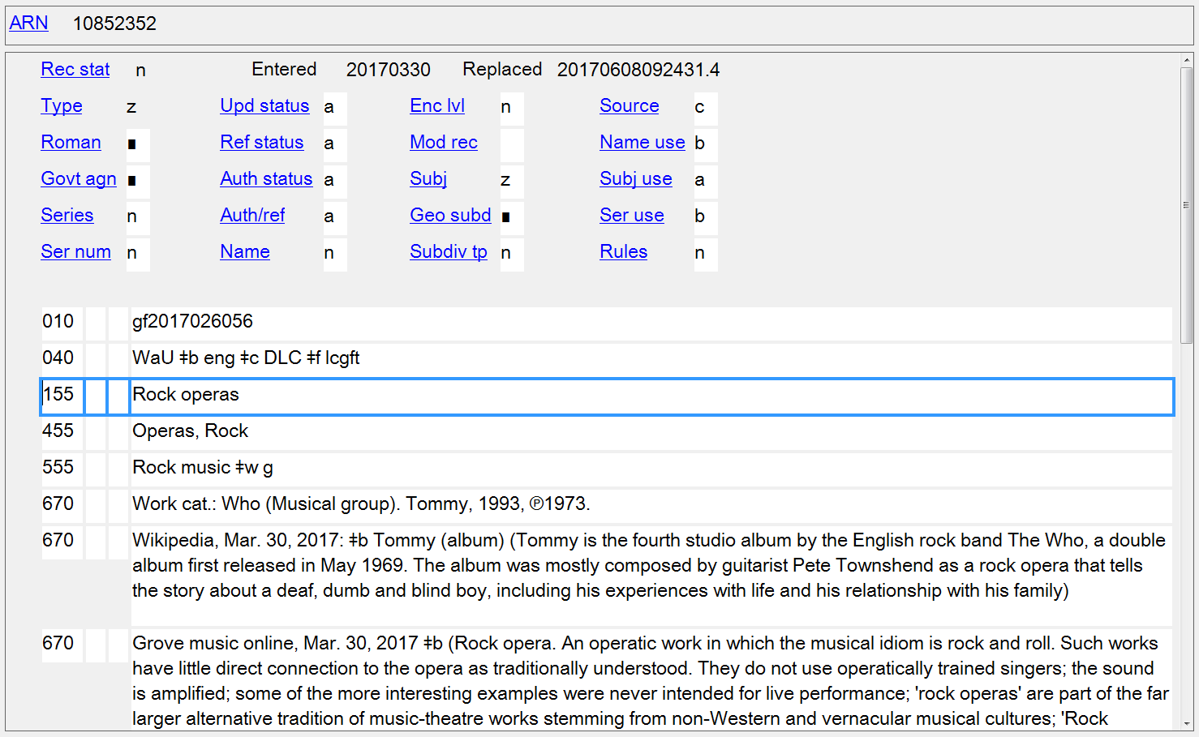
Notes:
LCGFT authority record in OCLC Connexion Client

Slide 9
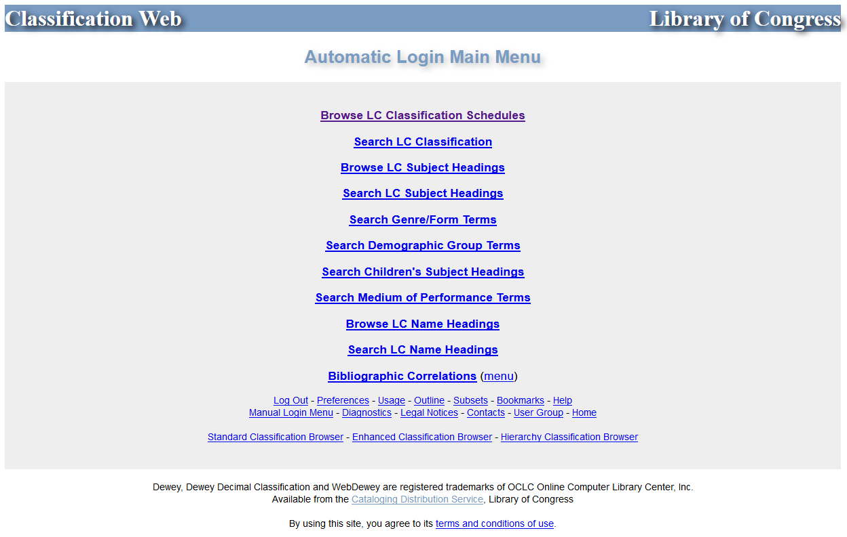
Notes:
Classification Web

Slide 10
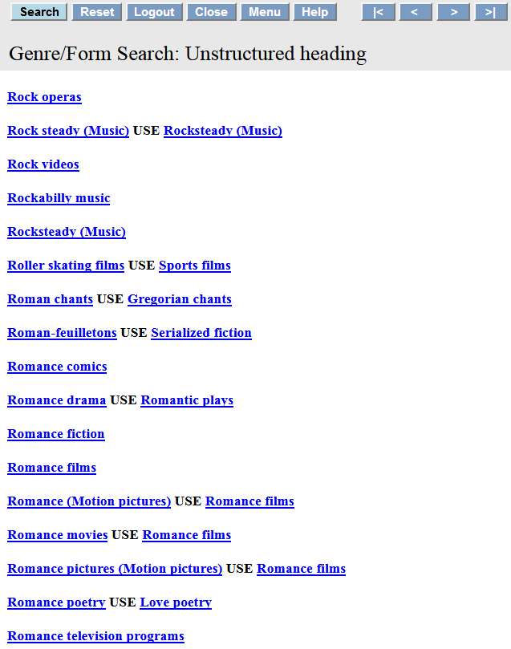
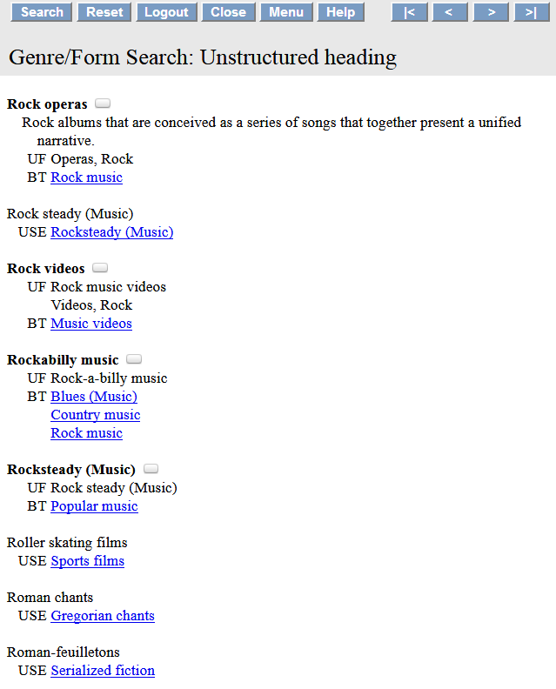
Scope note
Notes:
Classification Web search results for “Rock operas”. It’s important to check if there is a scope note to help guide you in the assignment of the term in question.

Slide 11
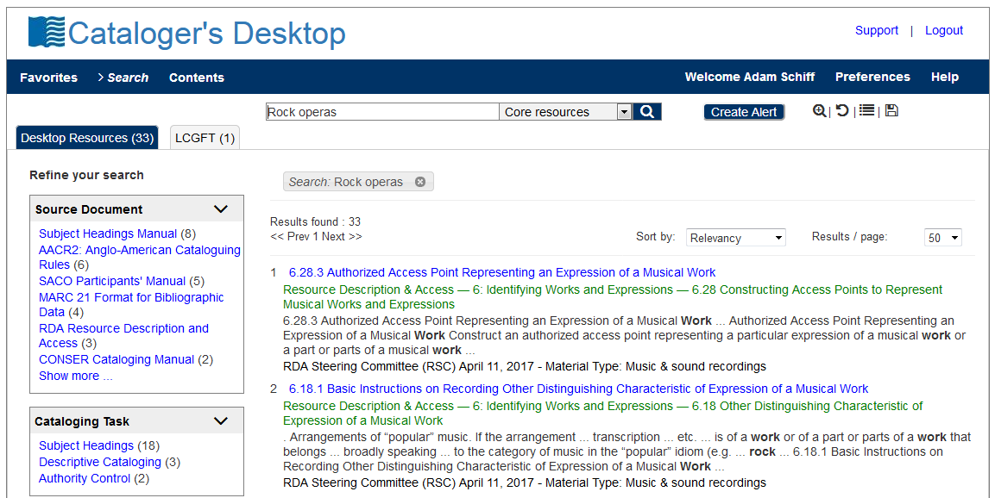
Notes:
Cataloger’s Desktop now includes searching of Classification Web, provided that you have a Class Web subscription.

Slide 12
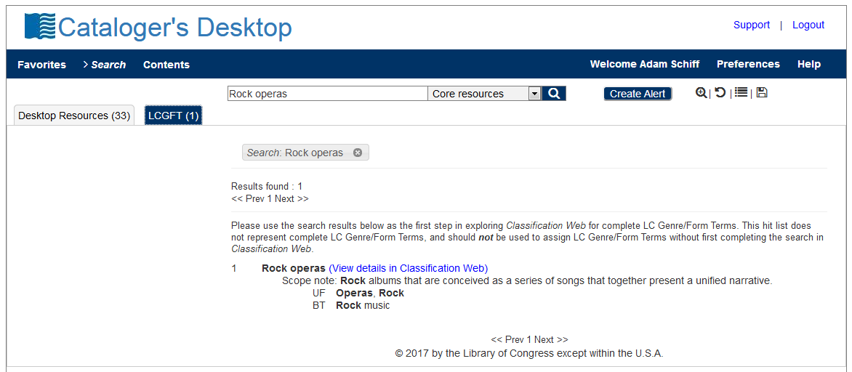

Slide 13
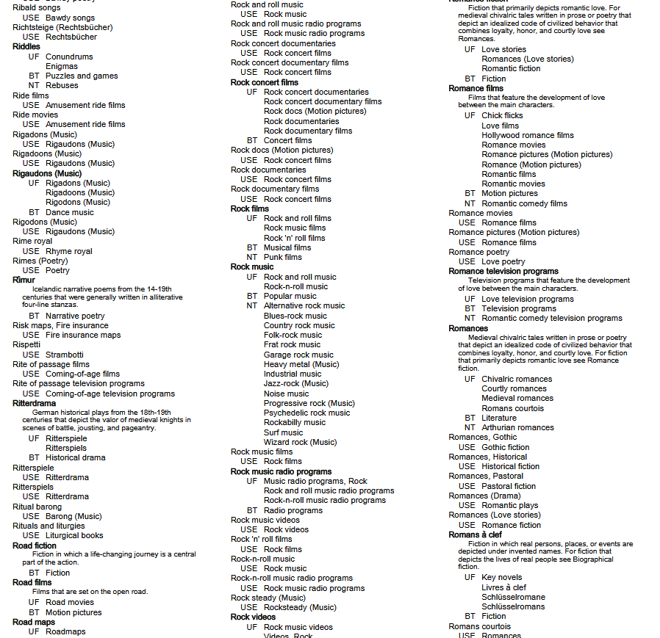
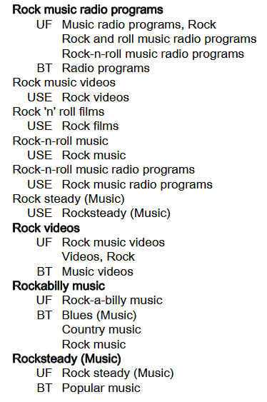
Notes:
ANIMATED SLIDE
This is a screenshot from PDF file of the 2017 Edition of the Library of Congress Genre/Form Terms for Library and Archival Materials (LCGFT). You will notice that our example, “Rock operas,” is not here. This illustrates the drawback of using the PDF file, as it is only compiled once a year, at the beginning of the year. Any terms added after will not be found in the PDF list until the following year.

Slide 14
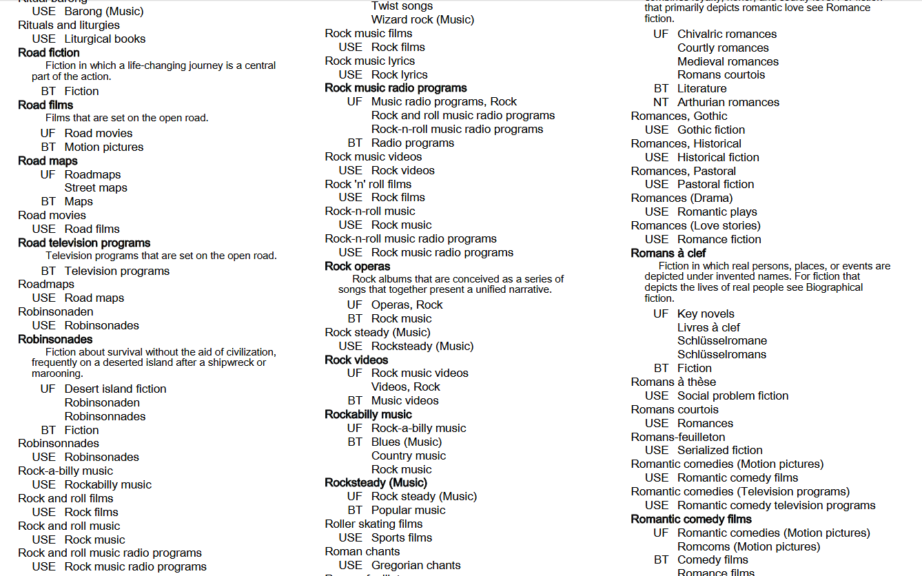
Notes:
This is the January 2018 PDF of LCGFT terms and you can see that the term Rock operas does now appear. However, all of the additions and changes made since January 2018 won’t be available on this version of the list.

Slide 15
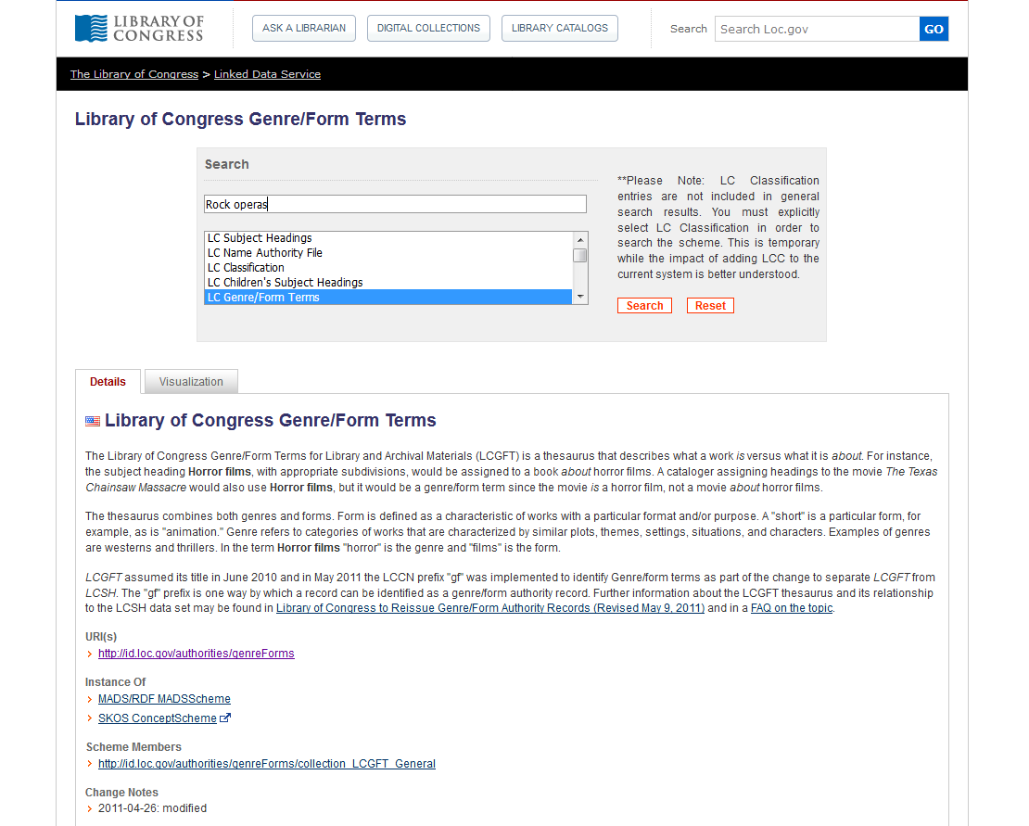
Notes:
LC Linked Data Service

Slide 16
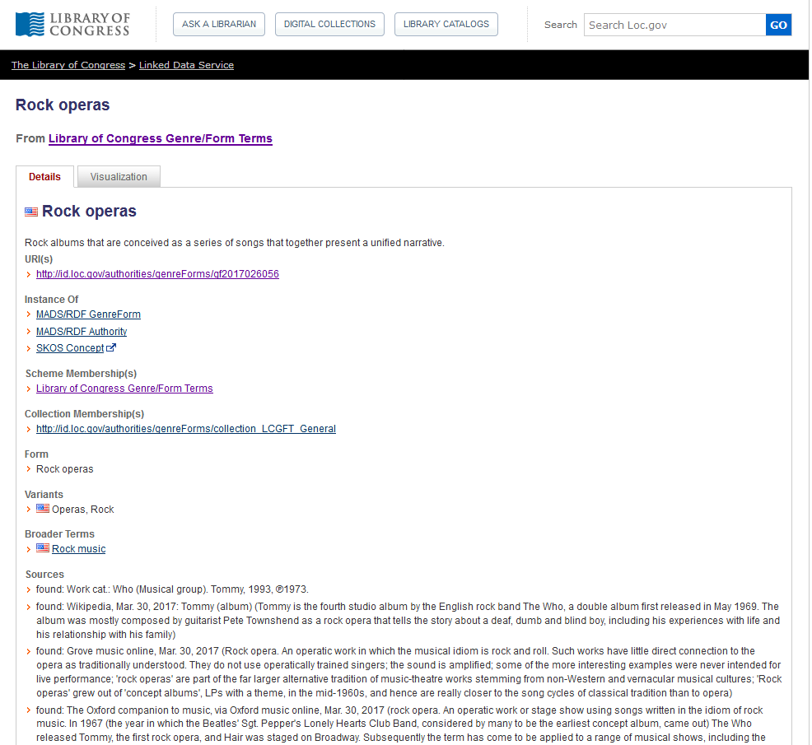
Notes:
LC Linked Data Service

Slide 17
Notes:
Library of Congress Authorities also includes authority records for LCGFT as well as LCSH.

Slide 19
LC Genre/Form Terms
General principles
Consult Introduction to Library of Congress Genre/Form Terms for Library and Archival Materials and the Library of Congress Genre/Form Terms Manual (http://www.loc.gov/aba/publications/FreeLCGFT/freelcgft.html)
Assigned both to individual works and to compilations
Terms that describe works and expressions are eligible: terms for the intellectual or artistic expression of the work and also the original mode of issuance, where applicable
Terms that describe manifestation attributes generally are ineligible (e.g., DVDs; Large print books; Miniature books; Paperbacks; Streaming video)
A few exceptional manifestation-level terms are in LCGFT (e.g., Internet videos; Video recordings for the hearing impaired), but they should not be considered precedents

Slide 20
LC Genre/Form Terms
General principles
Definition: “Genres and forms may be broadly defined as categories of resources that share known conventions. More specifically, genre/form terms may describe the purpose, structure, content, and/or themes of resources. Genre/form terms describing content and themes most frequently refer to creative works and denote common rhetorical devices that usually combine elements such as plot and setting, character types, etc. Such terms may be closely related to the subjects of the creative works, but are distinct from them.”

Slide 21
LC Genre/Form Terms
General principles
Exclusions: Several other characteristics of works and expressions are closely related to genres and forms, but are not eligible for explicit inclusion in LCGFT:
ethnicity, nationality, or other characteristics of creators (e.g., Korean drama; Uighur folk songs; Artists' writings; Films by children; Music by women composers; Shinto poetry; Taoist music; Mexican American posters)
intended audience (e.g., Children’s stories; Young adult drama; Music for the hearing impaired)
time period of creation (e.g., Medieval music; Han poetry; 19th century maps)
language (e.g., Urdu wit and humor; Arabic films)
place of creation (e.g., East Asian periodicals; Southern African newspapers)
country of production (e.g., Canadian films; Mexican television programs)
geographic location (e.g., works set in Miami)

Slide 22
LC Genre/Form Terms
General principles
Exclusions: Several other characteristics of works and expressions are closely related to genres and forms, but are not eligible for explicit inclusion in LCGFT:
the popularity of the work (e.g., blockbusters)
medium of performance (e.g., trumpet music)
terms that by their nature require a value judgment on the part of catalogers and users (e.g., racist films)
Excluded characteristics may be implicit within a genre or form (e.g., Fu is a Chinese poetic form from the Han Dynasty; Silent films generally come from a particular time period of the 20th century; Rubble films are set in the rubble of bombed-out European cities)
LCGFT has a few exceptional terms indicative of audience which should not be considered precedents (e.g., Children's films; Law for laypersons; Television programs for people with visual disabilities)

Slide 23
LC Genre/Form Terms
MARC coding
Use MARC 655 (Index Term--Genre/Form) and 380 (Form of Work) in bibliographic records
Use MARC 380 (Form of Work) and perhaps 372 (Field of Activity) in authority records
Include $2 lcgft in MARC fields when LCGFT terms are used
100 1_ Grahame-Smith, Seth, $e author.
245 10 Pride and prejudice and zombies : $b the classic regency romance--now with ultraviolent zombie mayhem / $c by Jane Austen and Seth Grahame-Smith.
655 _7 Zombie fiction. $2 lcgft
655 _7 Horror fiction. $2 lcgft
655 _7 Parodies (Literature) $2 lcgft
655 _7 Novels. $2 lcgft
130 _0 Wo hu cang long (Motion picture)
380 __ Motion pictures $a Action and adventure
films $a Martial arts films $a Romance films
$a Film adaptations $a Fiction films $a
Feature films $2 lcgft
430 _0 Crouching tiger, hidden dragon (Motion
picture)
Notes:
The RDA element “Form of work” can be recorded in bibliographic records, but is much more likely to be used in authority records. If 655 is used in bib records, the use of 380 is probably redundant.
OLAC’s Best Practices for Cataloging DVD-Video and Blu-ray Discs using RDA and MARC21, version 1.1 (November 2017) does give a recommendation to include 380 in video records:
Best Practice Recommendation: Provide a high-level term for the form of work if readily ascertainable. Take the term from a controlled vocabulary (e.g., LCGFT, LCSH, etc.) and capitalize the first word to provide consistency.
380 __ $a Television programs $2 lcgft
380 __ $a Motion pictures $2 lcgft

Slide 24
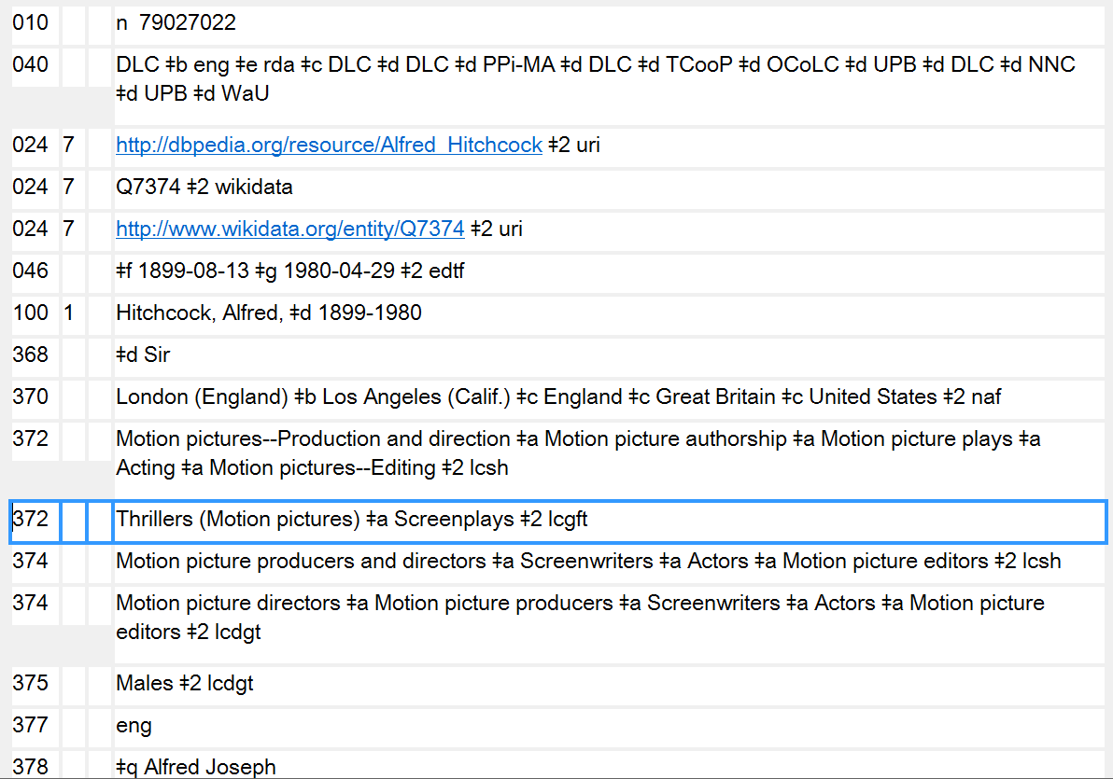
Notes:
Here’s an example of LCGFT terms used for Field of Activity (MARC 372). Alfred Hitchcock is well known as a director of suspense films and as a screenwriter.

Slide 25
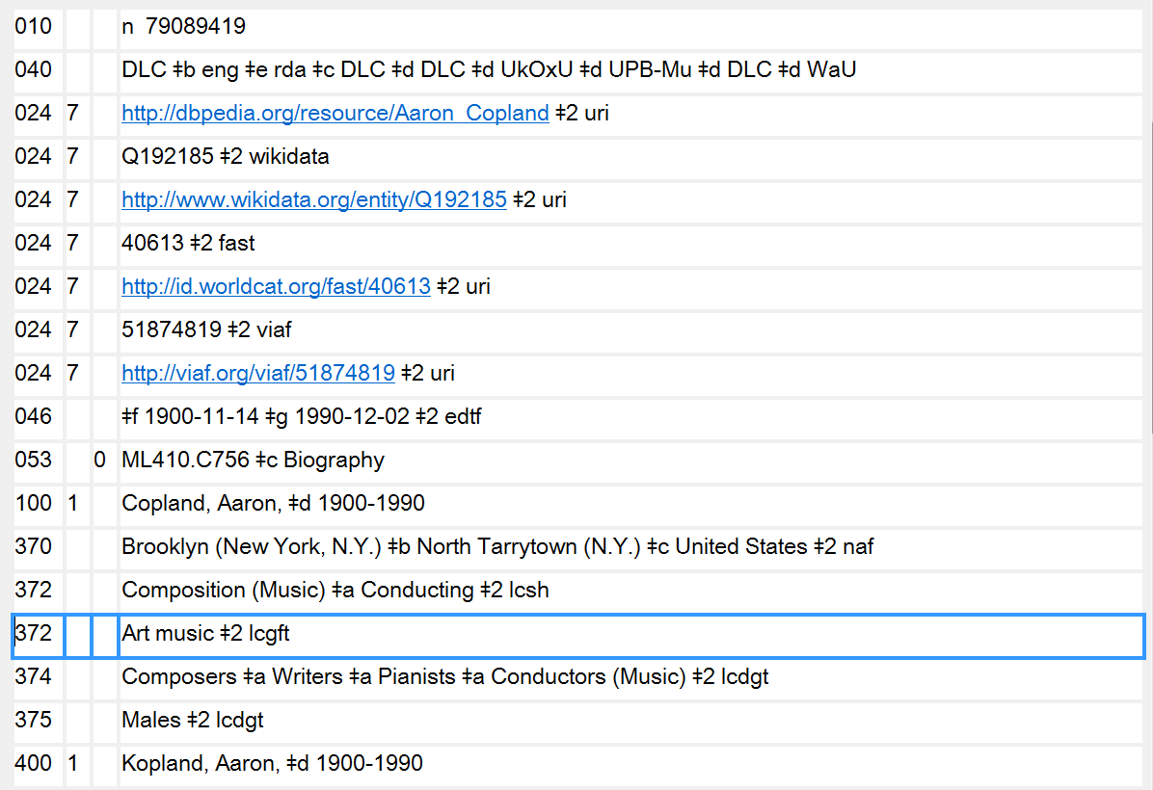
372 - Field of Activity in authority records may also contain genre/form terms
Notes:
Here’s another example of LCGFT terms used for Field of Activity (MARC 372). Aaron Copland was a composer of classical music, “Art music” in LCGFT.

Slide 26
LC Genre/Form Terms
General principles
May use subfield $3 when a term only applies to a part of a resource
245 04 The gold rush ; $b plus, Pay day / $c Film de Dam ; written and directed by Charlie Chaplin.
655 _7 Comedy films. $2 lcgft
655 _7 Silent films. $2 lcgft
655 _7 Fiction films. $2 lcgft
655 _7 $3 Gold rush: $a Feature films. $2 lcgft
655 _7 $3 Pay day: $a Short films. $2 lcgft
Notes:
The slide shows an example of using $3 in the 655 field. The DVD being cataloged contains two films. Both of the films are comedy films, silent films, and fiction films, so the first three 655s in the record apply to all the works. However, one of the works is a feature film and the other is a short film. In this example, the titles of the works that the genre/form term applies to have been used in the $3. But anything appropriate can go into the subfield, e.g. volume numbers, “1st work”, “2nd work”, accompanying disc, and so on. Use whatever is appropriate and makes the most sense.

Slide 27
LC Genre/Form Terms
General principles
May use subfield $3 when a term only applies to a part of a resource
245 02 A German requiem : $b op. 45 / $c Brahms. Bartered bride overture / Smetana. Rhapsodie espagnole / Ravel.
655 _7 Art music. $2 lcgft
655 _7 $3 A German requiem: $a Requiems. $2 lcgft
655 _7 $3 Bartered bride overture: $a Overtures. $2 lcgft
655 _7 $3 Rhapsodie espagnole: $a Rhapsodies (Music) $2 lcgft
Notes:
An example of a sound recording with three different genre/forms of works. $3 may be used to identify the work to which the genre/form term applies. The first term, “Art music,” applies to the compilation as a whole.

Slide 28
LC Genre/Form Terms
General principles
May use subfield $3 when a term only applies to a part of a resource
245 00 Tennessee River Civil War driving tour.
300 __ 1 audio disc (approximately 18 min.) : $b digital ; $c 4 3/4 in. + $e 1 videodisc (approximately
23 min. : sound, color ; 4 3/4 in.) + 1 color map (27 x 19 cm, on sheet 44 x 28 cm, folded to 14
x 11 cm)
520 __ Driving tour of Civil War sites in Tennessee, specifically along the Tennessee River and
surrounding area. Includes audio tour CD with accompanying map. The map includes an
audio CD legend of attractions and GPS coordinates, and URLs to local area tourist websites.
The accompanying DVD covers the same sites referenced on both the audio CD and map.
655 _7 $3 CD: $a Audiobooks. $2 lcgft
655 _7 $3 CD: $a Guidebooks. $2 lcgft
655 _7 $3 Accompanying DVD: $a Travelogues (Motion pictures) $2 lcgft
655 _7 $3 Accompanying DVD: $a Nonfiction films. $2 lcgft
655 _7 $3 Accompanying DVD: $a Short films. $2 lcgft
655 _7 $3 Accompanying map: $a Tourist maps. $2 lcgft
Notes:
Here’s a multipart monograph consisting of an audio disc, videodisc, and map. The use of $3 in 655 helps to identify what LCGFT terms apply to what part of the resource.

Slide 29
LC Genre/Form Terms
General principles
Specificity applies to genre/form the same as it does to subjects. Assign LCGFT terms that are specific to the resource being cataloged. A seemingly broad term like Poetry is specific when you’re cataloging a collection of poems in many different forms
Assign genre/form terms only as they come readily to mind after a superficial review of the resource being cataloged
Assign genre/form terms that correspond to the cataloging treatment of the resource. If cataloging a continuing resource such as a periodical, a monographic series, or a collected set, assign terms that characterize the resource as a whole. If cataloging a work as an analytic, assign terms that characterize the analytic

Slide 30
LC Genre/Form Terms
General principles
Assign terms based on analysis of the resource being cataloged. Genre/form terms do not need to be justified by descriptive cataloging elements
Assign to the resource being cataloged genre/form terms that describe the resource as a whole. Sometimes one term is sufficient, while at other times a complement of terms is necessary
Assign broader or more general terms when it’s not possible to establish a more specific term, when an array of terms is needed (e.g., for an animated science fiction romance film, three terms are needed: Animated films, Science fiction films, Romance films), or when the LCGFT Manual includes special instructions to do this

Slide 31
LC Genre/Form Terms
General principles
It is permissible to assign both a broader and a narrower term (for a compilation that consists of a predominant genre or form but includes a “significant proportion” of works that would be assigned another term in the hierarchy)
Example: anthology of oi music that also includes a significant proportion of other types of punk rock: assign both Oi music and Punk rock music
If there is a predominant genre/form, assign that term first; if predominant genre/form needs two terms to express it, assign them first
Notes:
First bullet:
GFTM J 110 says “Note: The use of the phrase ‘significant proportion’ is deliberate. Catalogers should take the intent of the resource into account and display good judgment when assigning terms from
multiple levels of the hierarchy in this manner.”

Slide 32
LC Genre/Form Terms
General principles
Don’t assign genre/form terms to works that have no discernible genre/form (e.g., a history of U.S. foreign relations in the 20th century)
For resources with separate parts (e.g., text plus an extensive bibliography or a section of maps; book with accompanying disc) also assign separate terms for the individual parts or materials if they are judged to be significant. May use $3 to identify the part to which a term applies
Notes:
LCGFT Manual J 110

Slide 33
LC Genre/Form Terms
General principles
Number of terms
If a resource consists of two or three genres that make up a broader genre, and that broader genre includes no other than those two or three genres within its scope, assign the broader genre instead of the two or three narrower genres
Title: The best Rosh ha-Shanah and Yom Kippur music: music of the High
Holidays
Term assigned: High Holiday music (rather than Rosh ha-Shanah music and Yom Kippur music)
Notes:
LCGFT Manual J 110
6. Two or three related terms. If a term exists, or can be established (see J 120), that (1) represents the two or three genres or forms displayed by a resource, and (2) includes no other genres or forms within its scope, assign one term instead of two or three narrower terms.

Slide 34
LC Genre/Form Terms
General principles
Number of terms - Rule of Three
If a genre/form term includes in its scope more than three sub-genres or forms, but the resource being cataloged consists of only two or three of those sub-genres or forms, assign the appropriate two or three terms instead of the broader term
Title: Time machine: the history of Canadian 60’s garage, punk, and surf, 1985-95
Terms assigned: Garage rock music
Punk rock music
Surf music
not Rock music, the broader term, because it has more than three NTs
Notes:
LCGFT Manual J 110
7. Rule of three. If a genre/form term includes in its scope more than three sub-genres or forms, but the resource being cataloged consists of only two or three of those sub-genres or forms, assign the appropriate two or three terms instead of the broader term.
If a resource displays more than three of the narrower terms of a single broader term, assign the broader term unless the rule of four, described below, applies.

Slide 35
LC Genre/Form Terms
General principles
Number of terms - Rule of Three
If a resource displays more than three of the narrower terms of a single broader term, assign the broader term unless the rule of four applies
Number of terms - Rule of Four
For resources that display four sub-genres or forms of a broader term, if the four sub-genres or forms comprise only a small portion of the scope of the broader term (i.e., the broader term has many narrower terms in addition to the four in question), assign the four sub-genres or forms instead of the broader term.
Example: poetry anthology that consists of four Japanese forms: Haiku, Senryu, Tanka, and Kyōka. Assign the four specific terms rather than Poetry
Notes:
LCGFT Manual J 110
7. Rule of three. If a genre/form term includes in its scope more than three sub-genres or forms, but the resource being cataloged consists of only two or three of those sub-genres or forms, assign the appropriate two or three terms instead of the broader term.
If a resource displays more than three of the narrower terms of a single broader term, assign the broader term unless the rule of four, described below, applies.
8. Rule of four. In certain circumstances it may be preferable to assign terms for four sub-genres or forms of a broad term. If a term covers a broad range and each sub-genre or form comprises only a small portion of that whole range, assign the four sub-genres or forms. For example, a poetry anthology that consists of haiku, senryu, tanka, and kyōka may be assigned terms for those
four genres instead of the broad term Poetry.
LC practice: Do not exceed four sub-genres or forms under any circumstances.

Slide 36
LC Genre/Form Terms
General principles
Bring out or account for each genre or form in the title and subtitle if they accurately represent the genre(s) and/or form(s) of the resource and if they are useful for retrieval
If the title is general but the work is actually of a more specific genre and/or form, assign terms for the specific genre or form
If many genres and/or forms are listed on the title page in the manner of a table of contents, treat them as a table of contents
Follow additional instructions in the manual for kinds of resources and disciplines (e.g., literature; moving images; radio programs)
Notes:
LCGFT Manual J 110

Slide 37
LC Genre/Form Terms
General principles
Objectivity: Avoid assigning terms that express personal value judgments and opinions about resources being cataloged. Consider the intent of the author or publisher, and if possible assign terms for this orientation without being judgmental (e.g., if collection says it’s humorous poetry, assign the appropriate term even if you don’t find the poems funny)
LCGFT terms are not authorized for any type of subdivision (no $x, $y, $z, or $v)
Not valid: 655 _7 Rock music $z Germany. $2 lcgft
655 _7 Rock music $y 2001-2010. $2 lcgft
Valid: 655 _7 Rock music. $2 lcgft
655 _4 Rock music $z Germany.
655 _4 Rock music $y 2001-2010.
Notes:
LCGFT Manual J 110
The last two valid examples are uncontrolled genre/form access points. They could be added in addition to the controlled form, but they may not be coded as being LCGFT.

Slide 38
LC Genre/Form Terms
General principles
If no predominant genre/form and not classified in a number that reflects genre/form, then assign terms in any order considered to be most useful
If terms are assigned for the whole resource and for parts of the resource, assign terms for the whole before terms for the parts
100 1_ Shaw, Bernard, $d 1856-1950, $e author.
245 10 Three plays for Puritans / $c Bernard Shaw ; definitive text under the editorial
supervision of Dan H. Laurence ; with an introduction by Michael Billington.
505 0_ The devil's disciple -- Caesar and Cleopatra -- Captain Brassbound's conversion.
655 _7 Drama. $2 lcgft
655 _7 $3 The devil's disciple ; Captain Brassbound's conversion: $a Melodramas (Drama)
$2 lcgft
655 _7 $3 Caesar and Cleopatra: $a Historical drama. $2 lcgft
655 _7 $3 Caesar and Cleopatra: $a Biographical drama. $2 lcgft
655 _7 $3 Captain Brassbound's conversion: $a Problem plays. $2 lcgft

Slide 39
“General” Terms
Terms which are not specific to a particular discipline
Abridgments Almanacs Bibliographies Blogs
Conference papers and proceedings Diaries Dictionaries
FAQs Guidebooks Newsletters Picture books
Sayings Textbooks Yearbooks Zines
Terms for ephemera Calendars Menus Theater programs
Terms for some graphic materials Posters Postcards Paper dolls
Terms for puzzles and games KenKen puzzles Sudoku puzzles
Terms for types of toy and movable books Flip books Pop-up books
Some nonfiction terms Autobiographies Biographies Diaries
Essays Travel writing True crime stories

Slide 40
“General” Terms
Many have corresponding headings or form subdivisions in LCSH, but the LCGFT headings may not be identical. For example:
LCSH: $v Biography LCSH: $v Congresses
LCGFT: Biographies LCGFT: Conference papers and proceedings
LCSH: $v Handbooks, manuals, etc. LCSH: Imaginary histories
LCGFT: Handbooks and manuals LCGFT: Counterfactual histories
LCSH: Playbills LCSH: Sound effects books
LCGFT: Playbills (Posters) LCGFT: Sound books
LCSH: $v Tables LCSH: $v Exhibitions
LCGFT: Tables (Data) LCGFT: Exhibition catalogs
Notes:
All LCGFT terms are in the plural form, unlike some LCSH headings. Terms in LCSH with “etc.” were deemed undesirable, so you won’t find them in LCGFT. All terms were reevaluated to be sure that they reflected current and common usage and made sense as stand-alone genre/form terms.

Slide 41
“General” Terms
Divided into 10 “top” terms: Commemorative works; Creative nonfiction; Derivative works; Discursive works; Ephemera; Illustrated works; Informational works; Instructional and educational works; Recreational works; Tactile works
These are mainly for gathering the general terms into broad categories; they will rarely be assigned in a bibliographic record because more specific terms are available
Some of the more specific terms may be in the hierarchies of multiple top terms. For example, Handbooks and manuals has two BTs, Instructional and educational works and Reference works, which is an NT of Informational works

Slide 42
General Term Examples
245 00 Dictionary of Florida historic places / $c
edited by Lorrie K. Owen.
650 _0 Historic buildings $z Florida $v Dictionaries.
650 _0 Historic sites $z Florida $v Dictionaries.
651 _0 Florida $x History, Local $v Dictionaries.
655 _7 Dictionaries. $2 lcgft
Notes:
A simple case where the LCGFT term is identical to the LCSH form subdivision.

Slide 43
General Term Examples
100 1_ Harper, Debra Kay, $e compiler, $e editor.
245 10 English/Seminole vocabulary : $b as
documented during the Second Seminole
War 1835-1842 / $c compiled and edited
by Debra Kay Harper ; introduction by
Frank Laumer.
650 _0 English language $v Dictionaries $x Seminole.
650 _0 Seminole language $v Dictionaries $x English.
655 _7 Multilingual dictionaries. $2 lcgft
Notes:
Another dictionary, but in this case there is a more specific LCGFT term available.

Slide 44
General Term Examples
100 1_ King, Coretta Scott, $d 1927-2006, $e author.
245 10 My life, my love, my legacy / $c Coretta Scott King as told to the
Rev. Dr. Barbara Reynolds.
250 __ Unabridged.
300 __ 1 online resource (1 sound file (14 hr., 30 min.)) : $b digital
655 _7 Autobiographies. $2 lcgft
655 _7 Audiobooks. $2 lcgft

Slide 45
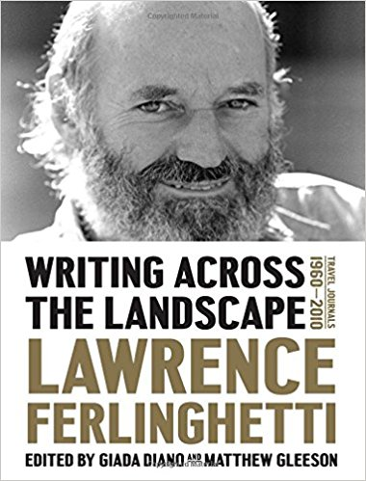
General Term Examples
100 1_ Ferlinghetti, Lawrence, $e author.
245 10 Writing across the landscape : $b travel journals 1960-2010 / $c
Lawrence Ferlinghetti ; edited by Giada Diano and Matthew Gleeson.
600 10 Ferlinghetti, Lawrence $v Diaries.
600 10 Ferlinghetti, Lawrence $x Travel.
655 _7 Diaries. $2 lcgft
655 _7 Travel writing. $2 lcgft

Slide 46
General Term Examples
100 1_ Jarvis, Carolyn, $e author.
245 10 Student laboratory manual for Physical
examination & health assessment, fourth
edition / $c Carolyn Jarvis, MSN, APN, CNP.
500 __ “... a study guide and laboratory manual to
accompany the textbook Physical examination
and health assessment, 4th edition"--Preface.
650 _0 Physical diagnosis $v Laboratory manuals.
650 _0 Nursing assessment $v Laboratory manuals.
655 _7 Laboratory manuals. $2 lcgft
655 _7 Study guides. $2 lcgft
655 _7 Problems and exercises. $2 lcgft
Notes:
Another simple case where the LCGFT term is identical to the LCSH form subdivision. It won’t always be this simple, however! And note, that in this case, two additional LCGFT terms are appropriate to add based on the content of the resource.

Slide 47
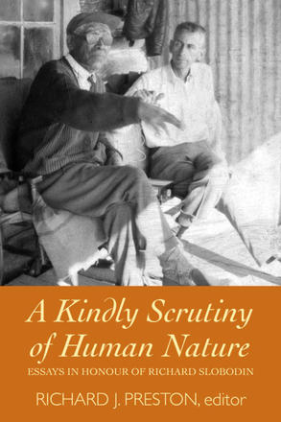
General Term Examples
Fixed Field 008: Biog b Fest 1
245 00 A kindly scrutiny of human nature : $b essays
in honour of Richard Slobodin / $c Richard J.
Preston, editor.
600 10 Slobodin, Richard, $d 1915-2005.
650 _0 Ethnology $z Canada, Northern.
650 _0 Anthropologists $z Canada $v Biography.
655 _7 Festschriften. $2 lcgft
655 _7 Biographies. $2 lcgft
700 1_ Slobodin, Richard, $d 1915-2005, $e honouree.
700 1_ Preston, Richard J., $d 1931- $e editor.

Slide 48
General Term Examples
110 2_ Florida College English Association. $b Annual Meeting
$d (2012 : $c Ybor City, Tampa, Fla.), $e author.
245 10 Florida studies : $b selected papers from the 2012 and
2013 Annual Meetings of the Florida College English
Association / $c edited by Paul D. Reich and Andrew
Leib.
650 _0 American literature $z Florida $x History and criticism
$v Congresses.
655 _7 Conference papers and proceedings. $2 lcgft
655 _7 Literary criticism. $2 lcgft
710 2_ Florida College English Association. $b Annual Meeting
$d (2013 : $c Ybor City, Tampa, Fla.), $e author.

Slide 49
General Term Examples
100 1_ Hammond, Amy, $e author.
245 10 When I grow up, I'll be a Gator! / $c Amy
Hammond ; illustrated by Charr Floyd.
385 __ Preteens $2 lcdgt
520 __ A young boy dreams of the day when he will
be old enough to attend the University of
Florida and support the college's Gator sports
programs.
610 20 Florida Gators (Football team) $v Juvenile fiction.
610 20 Florida Gators (Basketball team) $v Juvenile fiction.
610 20 University of Florida $v Juvenile fiction.
655 _7 Picture books. $2 lcgft
655 _7 Fiction. $2 lcgft

Slide 50
General Term Examples
245 00 Clearwater-opoly.
246 3_ Clearwateropoly
500 __ “A fun game celebrating the
top beach town in Florida”--
Box cover.
655 _7 Board games. $2 lcgft

Slide 51
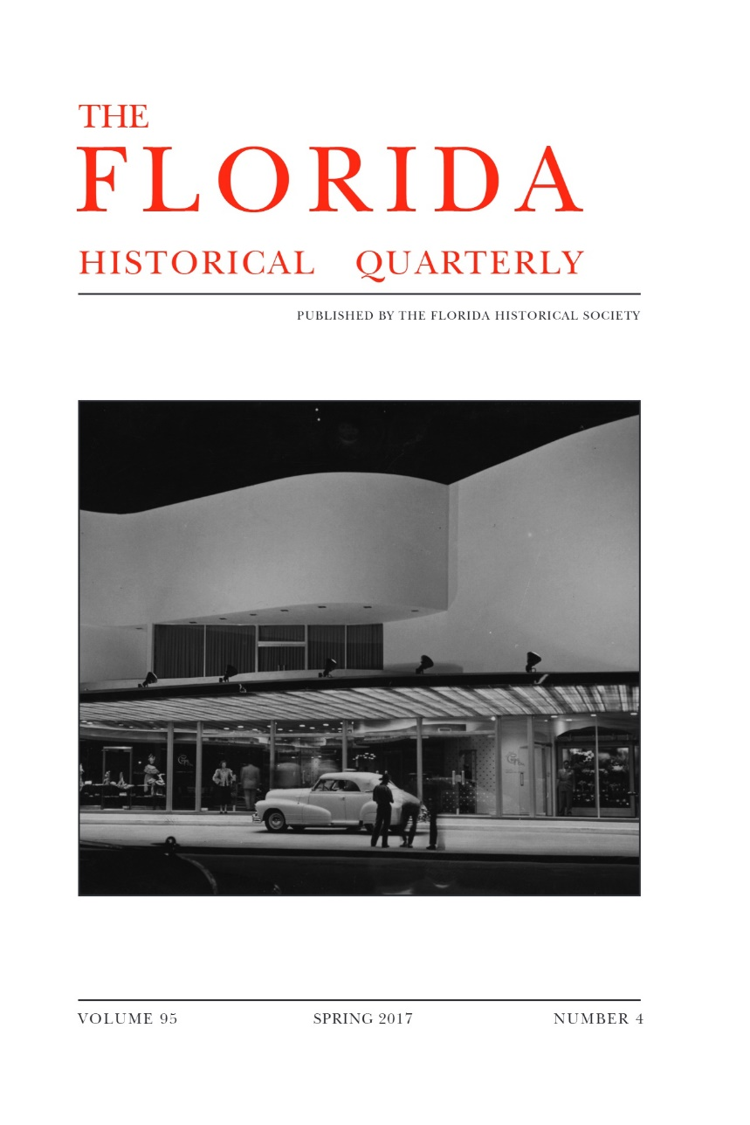
General Term Examples - Serials
245 04 The Florida historical quarterly.
310 __ Quarterly
651 _0 Florida $x History $v Periodicals.
655 _7 Periodicals. $2 lcgft
710 2_ Florida Historical Society, $e
issuing body.

Slide 52
General Term Examples - Serials
110 2_ Smithsonian Marine Station at Fort
Pierce (Fort Pierce, Fla.), $e author.
245 10 Annual report / $c Smithsonian Marine
Station at Fort Pierce.
310 __ Annual
610 20 Smithsonian Marine Station at Fort
Pierce (Fort Pierce, Fla.) $v Periodicals.
650 _0 Marine biology $x Research $z Florida
$v Periodicals.
655 _7 Annual reports. $2 lcgft
Notes:
Another situation in which the LCGFT term assigned does not correspond to the form subdivision used in the subject headings. Annual reports is the specific term appropriate to this work, so only it is assigned from LCGFT.
Note: just because something is issued annually does not make it an “Annual report”
The form subdivision $v Periodicals is used in a much broader sense than the actual definition of the term. Although one might assign the LCGFT term Periodicals, probably the broader term Serial publications is more appropriate for this publication.
From the Subject Headings Manual H 1927: “In subject cataloging practice the term periodical is defined as a publication other than a newspaper that is actually or purportedly issued according to a regular schedule (monthly, quarterly, biennially, etc.) in successive parts, each of which bears a numerical or chronological designation, and that is intended to be continued indefinitely. This definition is broader than the traditional definition, which states that a periodical is generally published more frequently than annually and normally contains separate articles. The term serial is frequently used in a broader sense to refer to any title cataloged as a serial, including periodicals, newspapers, monographic series, etc. The subdivision –Periodicals is used under headings assigned to serials that conform to the subject cataloging definition of periodicals.”

Slide 53
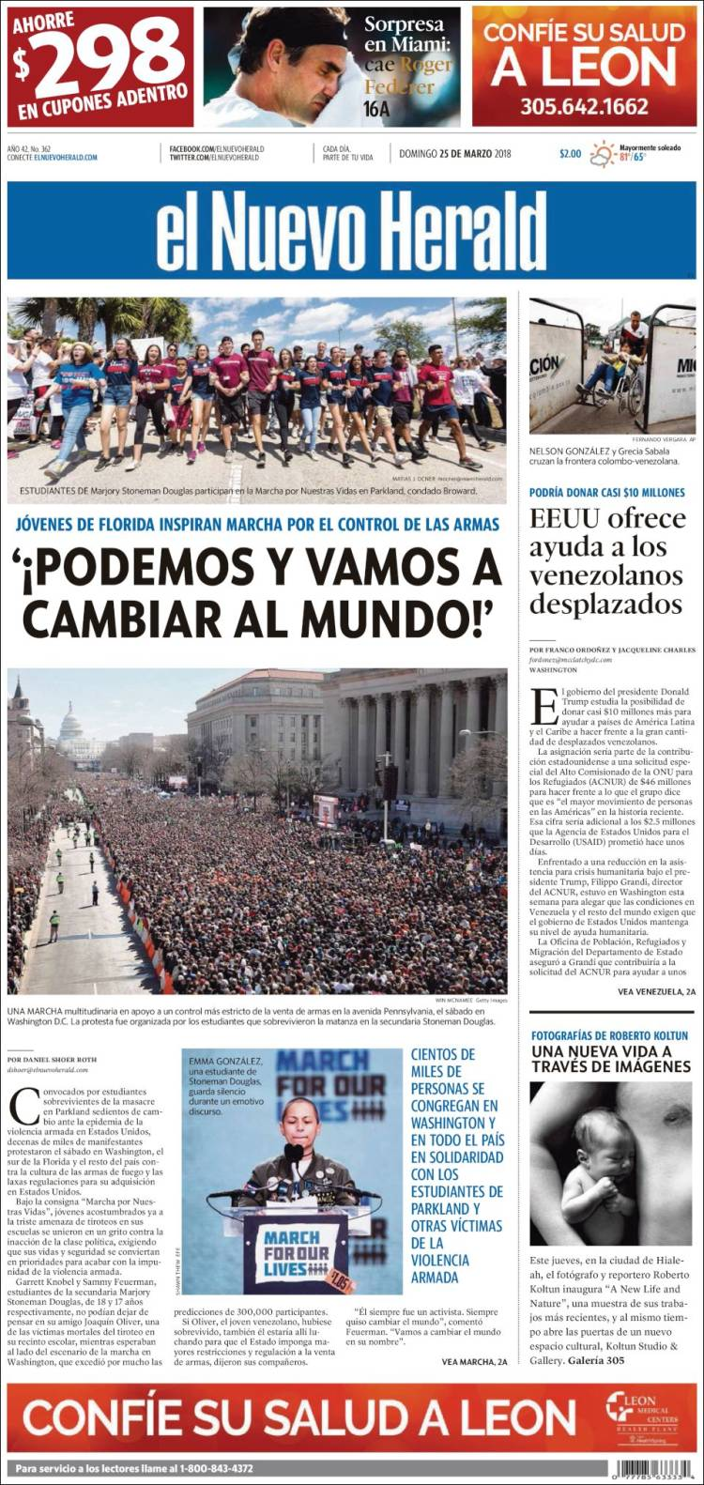
General Term Examples - Serials
245 03 El nuevo herald.
__ Daily
362 0_ Vol. 1, no. 1 (21 de nov. 1987)-
650 _0 Hispanic Americans $z Florida $v Newspapers.
651 _0 Miami (Fla.) $v Newspapers.
651 _0 Miami-Dade County (Fla.) $v Newspapers.
655 _7 Newspapers. $2 lcgft
655 _7 Hispanic American newspapers. $2 ngl
Notes:
Although LCGFT does not allow explicit inclusion of the audience or creators of a work, you can see that the Newspaper Genre List ($2 ngl) does have such terms.

Slide 54
LCGFT
Literature Terms

Slide 55
LCGFT Literature Terms
Top term: Literature
Used only for collections of literary works composed of multiple genres/forms to which more specific terms cannot be applied.
Five high-level terms under Literature:
Comics (Graphic works)
Drama
Fiction
Folk literature
Poetry
Notes:
The top term Literature is unlikely to be used very much, since more specific terms will generally be available. The scope not for it says: Collections of literary works that are composed of multiple genres and/or forms to which more specific headings such as Lyric poetry or Science fiction cannot be applied.
All of the terms below Literature may be used for both collections and individual works.

Slide 56
LCGFT Literature Terms
Many have corresponding headings in LCSH, but the LCGFT headings may not be identical. For example:
LCSH: Adventure stories LCSH: Motion picture plays LCSH: Horror comic books, strips, etc.
LCGFT: Action and adventure fiction LCGFT: Screenplays LCGFT: Horror comics
LCSH: Comic books, strips, etc. LCSH: Nonfiction novel LCSH: Gothic fiction (Literary genre)
LCGFT: Comics (Graphic works) LCGFT: Nonfiction novels LCGFT: Gothic fiction
LCSH: Horror tales LCSH: Moralities LCSH: Spy stories
LCGFT: Horror fiction LCGFT: Morality plays LCGFT: Spy fiction
LCSH: Plot-your-own stories LCSH: Comedy LCSH: Tragedy
LCGFT: Choose-your-own stories LCGFT: Comedy plays LCGFT: Tragedies (Drama)
LCSH: Mysteries and miracle-plays LCSH: Magic realism (Literature) LCSH: Suspense fiction
LCGFT: Mystery and miracle plays LCGFT: Magic realist fiction LCGFT: Suspense fiction and Thrillers (Fiction)
Notes:
All LCGFT terms are in the plural form, unlike some LCSH headings.

Slide 57
LCGFT Literature Terms
Explicit aspects like audience, creator characteristics, place of origin, language, and time period of creation that are often included in LCSH were out of scope for LCGFT if they are explicit in the term, so you will not find terms like these from LCSH: Children’s poetry; Buddhist stories; Christian fiction; Gay men’s writings; College prose; Byzantine literature; Literature, Medieval; Chinese drama
However, when not explicit, terms may be in LCGFT, e.g.
Azharot Jewish liturgical poems on 613 commandments in the Torah
Bible plays specific religion is not explicit
Chansons de geste a medieval French genre
Comedies of humours an English 16th-17th century drama genre
Fabliaux bawdy medieval tales
Hyangga Korean poetry from Unified Silla (668-935) and Koryŏ dynasties (935-1392)
Jataka stories Buddhist tales about the previous births of the Buddha

Slide 58
LCGFT Literature Terms
Exclusions from LCGFT
Terms that require a value judgment on the part of catalogers and users are ineligible, e.g., Feminist fiction; Patriotic poetry
Terms for literary movements, e.g., Dadaist poetry; Expressionist drama; Beat literature
However, style and technique are eligible, e.g., Frame stories; Metadramas; Parodies (Literature); Noir comics; Satirical literature; Stream of consciousness fiction
Notes:
Frame stories: stories that contain other stories
Metadramas: drama that self-consciously calls attention to its own fictional status as a theatrical pretense, often through the use of a play-within-a-play

Slide 59
LCGFT Literature Terms
LCGFT Manual J 235
Special provisions for literature:
Fiction: in addition to other genre/form terms, assign a term for length when it is readily apparent (Novels; Novellas; Short stories; Flash fiction)
Poetry: For both individual poems and collections of poetry, rely chiefly on the title, introduction, cover information, etc., to determine whether the poetry is of a specific genre or form. If after a superficial review a specific genre or form cannot be determined, assign the term Poetry
Poetry: If the genre or form of a poem or collection of poetry is known to the cataloger due to the cataloger’s academic or cultural background, etc., one or more genre/form terms may be assigned to represent the genre or form (e.g., you know that Homer’s Odyssey is Epic poetry even if the resource you’re cataloging doesn’t say it is)
Notes:
1. Fiction. In addition to terms assigned in accordance with the guidelines in J 110, assign a term that indicates the length of the resource when it is readily apparent (e.g., Novels; Novellas; Short stories; Flash fiction).
Flash fiction: very short fiction of just a page or two; short stories of extreme brevity.

Slide 60
Literature Examples - Fiction
245 00 Suicidally beautiful : $b a collection of sport stories / $c edited
by Dennis F. Bormann & Stephen Taylor.
264 _1 Charlotte, North Carolina : $b Mint Hill Books, $c [2012]
650 _0 Sports stories, American.
650 _0 Short stories, American.
655 _7 Sports fiction. $2 lcgft
655 _7 Short stories. $2 lcgft
Notes:
A collection of short stories about sports.

Slide 61
Literature Examples - Fiction
100 1_ Proulx, Annie, $e author.
245 10 Brokeback Mountain / $c Annie Proulx.
260 __ New York : $b Scribner, $c 2005.
300 __ 55 pages ; $c 19 cm
650 _0 Cowboys $v Fiction.
650 _0 Ranch life $v Fiction.
650 _0 Gay men $v Fiction.
651 _0 Wyoming $v Fiction.
655 _7 Gay fiction. $2 lcgft
655 _7 Romance fiction. $2 lcgft
655 _7 Western fiction. $2 lcgft
655 _7 Short stories. $2 lcgft
Notes:
An individually published short story.

Slide 62
Literature Examples - Fiction
100 1_ Rawlings, Marjorie Kinnan, $d 1896-1953, $e author.
245 14 The yearling / $c Marjorie Kinnan Rawlings ; illustrations
by Edward Shenton ; with an introduction by Ivan Doig.
650 _0 Wild animals as pets $v Fiction.
650 _0 Parent and child $v Fiction.
650 _0 Farm life $v Fiction.
650 _0 Deer $v Fiction.
650 _0 Boys $v Fiction.
651 _0 Florida $v Fiction.
655 _7 Novels. $2 lcgft
655 _7 Bildungsromans. $2 lcgft
655 _7 Animal fiction. $2 lcgft
655 _7 Domestic fiction. $2 lcgft
Notes:
A classic Florida novel.

Slide 63
Literature Examples - Fiction
245 00 한국 공포 문학 단편선.
245 00 Han'guk kongp'o munhak tanp'yŏnsŏn.
310 Annual
362 1_ Began in 2006.
650 _0 Horror tales, Korean $v Periodicals.
650 _0 Short stories, Korean $v Periodicals.
650 _0 Korean fiction $y 21st century $v Periodicals.
655 _7 Horror fiction. $2 lcgft
655 _7 Short stories. $2 lcgft
655 _7 Serial publications. $2 lcgft
Notes:
This is a compilation of works by different authors, issued as an annual publication, so here we have literature genre/form terms and a general term. For the fiction aspect, two terms are given, one for the genre (horror) and one for the length (short stories).
Genre/Form Terms Manual J 235 Literature
1. Fiction. In addition to terms assigned in accordance with the guidelines in J 110, assign a term that indicates the length of the resource when it is readily apparent (e.g., Novels; Novellas; Short stories; Flash fiction).

Slide 64
Literature Examples - Poetry
100 1_ Tolmie, Sarah, $e author.
245 10 Trio / $c Sarah Tolmie.
490 1_ The Hugh MacLennan poetry series
500 __ "A collection of 120 sonnets in eight parts,
Trio reveals, frame by frame, a married
fortysomething female narrator in love
with two younger men … and torn between
the claims of body and mind”--Page 4 of cover.
650 _0 Love poetry, Canadian.
650 _0 Sonnets, Canadian.
655 _7 Love poetry. $2 lcgft
655 _7 Sonnets. $2 lcgft
Notes:
A collection by one author.

Slide 65
Literature Examples - Poetry
100 1_ Pope, Alexander, $d 1688-1744, $e author.
245 14 The rape of the lock / $c Alexander Pope ;
edited by Elizabeth Gurr.
650 _0 Young women $v Poetry.
650 _0 Catholics $z England $v Poetry.
650 _0 Aristocracy (Social class) $z England $v Poetry.
650 _0 Pride and vanity $v Poetry.
655 _7 Mock-heroic poetry. $2 lcgft
655 _7 Narrative poetry. $2 lcgft
Notes:
An individually published poem.
LCGFT Manual J 235: “If the genre or form of a poem or collection of poetry is known to the cataloger due to the cataloger’s academic or cultural background, etc., one or more genre/form terms may be assigned to represent the genre or form.”

Slide 66
Literature Examples - Poetry
245 00 White lotus : $b a journal of haiku & senryu poetry.
310 __ Semiannual
362 0_ Issue #1 (fall/winter 2005)-
650 _0 Haiku, American $v Periodicals.
650 _0 Senryu, American $v Periodicals.
655 _7 Haiku. $2 lcgft
655 _7 Senryu. $2 lcgft
655 _7 Periodicals. $2 lcgft
Notes:
A journal that publishes two kinds of poetry.

Slide 67
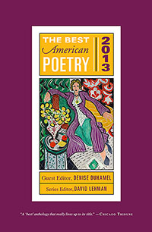
Literature Examples - Poetry
245 04 The best American poetry.
260 New York, N.Y. : $b Collier Books, $c c1988-
260 3_ $3 <2011->: $a New York : $b Scribner Poetry
310 Annual
362 0_ 1988-
650 _0 American poetry $y 20th century $v Periodicals.
650 _0 American poetry $y 21st century $v Periodicals.
655 _7 Poetry. $2 lcgft
655 _7 Serial publications. $2 lcgft
Notes:
Here we have both a literature genre/form term and a general term. The broad term Poetry is used, as the collection contains a large variety of different types of poems.

Slide 68
Literature Examples - Comics
100 1_ Feiffer, Jules, $e author, $e artist.
245 10 Kill my mother : $b a graphic novel / $c Jules Feiffer.
650 _0 Private investigators $v Comic books, strips, etc.
650 _0 Murder $v Comic books, strips, etc.
655 _7 Graphic novels. $2 lcgft
655 _7 Noir comics. $2 lcgft

Slide 69
Literature Examples - Comics
100 1_ Limke, Jeff, $e author.
245 10 Isis & Osiris : $b to the ends of the Earth : an
Egyptian myth / $c story by Jeff Limke ; pencils
and inks by David Witt.
600 00 Isis $c (Egyptian deity) $v Comic books, strips, etc.
600 00 Osiris $c (Egyptian deity) $v Comic books, strips,
etc.
650 _0 Mythology, Egyptian $v Comic books, strips, etc.
655 _7 Mythological comics. $2 lcgft
655 _7 Graphic novels. $2 lcgft

Slide 70
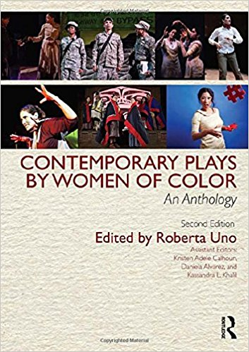
Literature Examples - Drama
245 00 Contemporary plays by women of color : $b
an anthology / $c edited by Roberta Uno ;
assistant editors: Kristen Adele Calhoun,
Daniela Alvarez, and Kassandra L. Khalil.
650 _0 American drama $x Minority authors.
650 _0 American drama $x Women authors.
650 _0 American drama $y 20th century.
650 _0 American drama $y 21st century.
650 _0 Women $z United States $v Drama.
650 _0 Minority women $v Drama.
650 _0 Minorities $v Drama.
655 _7 Drama. $2 lcgft
Notes:
A collection of plays. No particular genre identified.

Slide 71
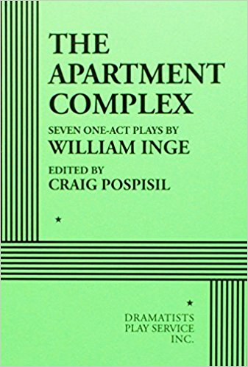
Literature Examples - Drama
100 1_ Inge, William, $e author.
240 10 Plays. $k Selections
245 14 The apartment complex : $b seven one-act plays /
$c by William Inge ; edited by Craig Pospisil.
264 _1 New York : $b Dramatists Play Service, $c [2016]
505 00 $t Margaret's bed -- $t The killing -- $t The power
of silence -- $t Prodigal -- $t The call -- $t The love
death -- $t Moved-in.
520 __ Seven one-act plays set in a large apartment complex
on the Upper West Side of New York City.
650 _0 Apartment houses $v Drama.
651 _0 Upper West Side (New York, N.Y.) $v Drama.
651 _0 New York (N.Y.) $v Drama.
655 _7 One-act plays. $2 lcgft
Notes:
A collection of plays by one author in a single form. No particular genre identified.

Slide 72
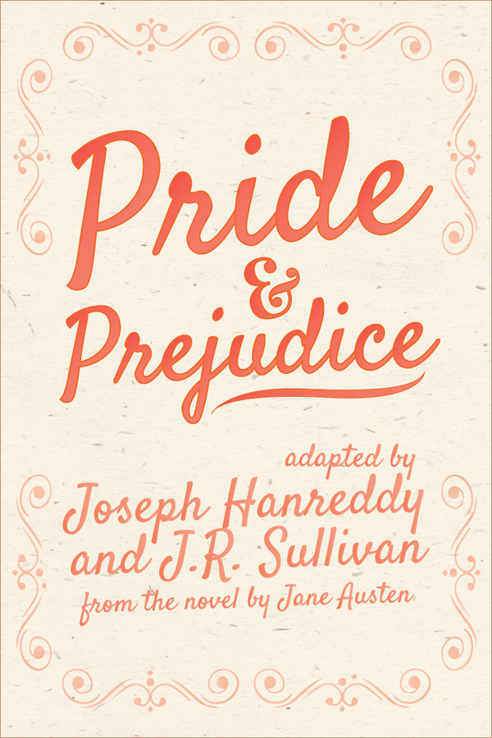
Literature Examples - Drama
100 1_ Hanreddy, Joseph, $e author.
245 10 Pride & prejudice / $c by Jane Austen ; adapted
for the stage by Joseph Hanreddy & J.R. Sullivan.
600 10 Bennet, Elizabeth $c (Fictitious character) $v
Drama.
600 10 Darcy, Fitzwilliam $c (Fictitious character) $v
Drama.
650 _0 Young women $z England $v Drama.
650 _0 Courtship $v Drama.
650 _0 Sisters $z England $v Drama.
655 _7 Domestic drama. $2 lcgft
655 _7 Romantic plays. $2 lcgft
655 _7 Historical drama. $2 lcgft
655 _7 Theatrical adaptations. $2 lcgft
Notes:
An individual work with multiple genres and a form (Theatrical adaptations).

Slide 73
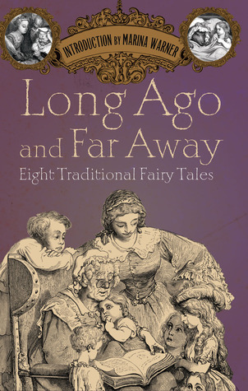
Literature Examples - Folk Literature
245 00 Long ago and far away : $b eight traditional fairy tales
/ $c foreword by Marina Warner ; translated by
Nigel Bryant, David Carter and Ann Lawson Lucas.
505 0_ Sleeping beauty from Perceforest -- Cinderella from
La gatta Cennerentola -- Snow White from La
Schiavottella -- Little Red Riding Hood from Le petit
chaperon rouge -- Little Red Riding Hood from Le
conte de la mère-grand -- Hansel and Gretel from Le
petit poucet -- Jack and the beanstalk -- Beauty and
the Beast from La belle et la bête -- The Little Mermaid
from Undine.
650 _0 Fairy tales.
655 _7 Fairy tales. $2 lcgft

Slide 74
Literature Examples - Folk Literature/Poetry
100 1_ Agee, Jon, $e author.
245 10 Orangutan tongs : $b poems to tangle your tongue / $c by
Jon Agee.
650 _0 Tongue twisters.
650 _0 Humorous poetry, American.
650 _0 Children's poetry, American.
655 _7 Tongue twisters. $2 lcgft
655 _7 Humorous poetry. $2 lcgft

Slide 75
Artistic and Visual Works Terms
Top term: Visual works
Art top term: Art
LCGFT Manual Instruction Sheet: none yet
SACO proposals not yet accepted
Notes:
The initial group of artistic and visual works terms were approved in February 2018, so this is the newest group of terms added to LCGFT. From the Introduction to LCGFT (https://www.loc.gov/aba/publications/FreeLCGFT/2018%20LCGFT%20intro.pdf):
“The project to establish genre/form terms for artistic and visual works was a collaboration between the Cataloging Advisory Committee (CAC) of the Art Libraries Society of North America and LC. The project initially focused solely on terms used to describe artistic works, but materials that are acquired for art collections are not always inherently artistic. That is, the materials are not “art for art’s sake” but are created to serve an informational, documentary, or other purpose (e.g., architectural drawings, trading cards, photographs). The practical need for terms to describe materials that are visual but not necessarily artistic led the CAC and PSD to determine that the highest-level broader term for those materials should be Visual works.
“That decision led to the reconsideration of the hierarchies in LCGFT because numerous authorized terms describe visual materials. The former broadest terms Motion pictures, Television programs, and Video recordings are now narrower terms under Visual works, and so is the high-level term Maps. The hierarchies for several other individual terms that refer to visual materials were also adjusted.”

Slide 76
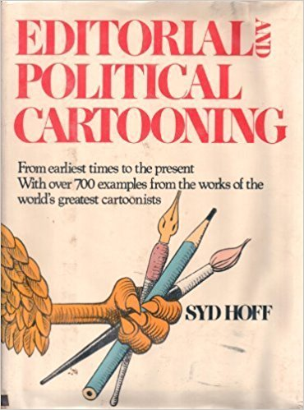
Art Examples
100 1_ Hoff, Syd, $d 1912-2004.
245 10 Editorial and political cartooning : $b from
earliest times to the present, with over 700
examples from the works of the world's
greatest cartoonists / $c Syd Hoff.
650 _0 Editorial cartoons $x History.
650 _0 World politics $x Caricatures and cartoons
$x History.
650 _0 Political cartoons.
655 _7 Political cartoons. $2 lcgft

Slide 77
Art Examples
100 1_ Kardashian, Kim, $d 1980- $e author, $e
photographer.
245 10 Selfish / $c Kim.
600 10 Kardashian, Kim, $d 1980- $v Self-portraits.
650 _0 Television personalities $z United States $v
Portraits.
650 _0 Celebrities $z United States $v Portraits.
650 _0 Portrait photography.
655 _7 Self-portraits. $2 lcgft
655 _7 Photographs. $2 lcgft

Slide 78
Art Examples
100 1_ Seligmann, Claus, $e creator.
245 10 Claus Seligmann papers.
264 _0 $c 1957-1988.
520 __ Scrapbook with photographs, floor plans, and sketches from Seligmann's early
architecture projects, primarily in England. Also included are lecture notes and
writings published by Seligmann.
545 __ Claus Seligmann was a Professor of Architecture at the University of Washington,
where he joined the faculty in 1964. He was born in Germany on August 12, 1927
and died in Seattle on November 14, 2014.
655 _7 Albums (Books) $2 lcgft
655 _7 Photographs. $2 lcgft
655 _7 Floor plans. $2 lcgft
655 _7 Architectural drawings. $2 lcgft

Slide 79
Moving Image Terms
Top terms: Motion pictures and Television programs. Only used for collections composed of multiple genres and/or forms
LCGFT Manual Instruction Sheet J 240:
The word films refers to resources that are originally recorded and released on motion picture film, on video, or digitally. The phrase television programs refers to those resources that were intended to be telecast.
Assign one of these terms: Fiction films; Nonfiction films; Fiction television programs; Nonfiction television programs
For films, assign either Short films (< 40 min.) or Feature films (40 min. or longer) as appropriate

Slide 80
Moving Image Terms
LCGFT Manual Instruction Sheet J 240:
For moving image resources produced with captions or sign language for viewing by the hearing impaired assign: Films for the hearing impaired or Television programs for the hearing impaired
For moving image resources with additional audio description provided for people with visual disabilities assign: Films for people with visual disabilities or Television programs for people with visual disabilities.
Local policy decision: instead of or in addition to above, may assign Video recordings for the hearing impaired and/or Video recordings for people with visual disabilities
Notes:
First and second subbullets: Note: The terms describe audiences, not genres or forms, and are provided in LCGFT as exceptions.
The terms Video recordings for the hearing impaired and Video recordings for people with visual disabilities, which likewise refer to audiences, are also provided as exceptions. Individual libraries may choose to develop local policies to assign them instead of, or in addition to, the above required terms.

Slide 81
Moving Image Terms
OLAC’s Library of Congress Genre-Form Thesaurus (LCGFT) for Moving Images: Best Practices (http://www.olacinc.org/sites/capc_files/LCGFTbestpractices.pdf)
Terms may be assigned from different levels of the same hierarchy if desired (e.g., Slasher films as well as Horror films; Sex comedy films as well as Comedy films)
Fiction vs. nonfiction: useful for limiting/faceting; guidelines for borderline cases
When to assign Short films and Feature films: films or videos that have been or are likely to have been originally exhibited theatrically or otherwise shown publicly and for films and videos similar in structure and style to films shown in theatrical venues where users may find these categories useful
Accessibility terms: base accessibility form terms on the format in hand, normally video recordings, rather than the original format. Films for the hearing impaired and Films for people with visual disabilities should thus only be used when cataloging moving images in film format. Television programs for [. . .] terms would not be used at all
Notes:
OLAC’s Library of Congress Genre-Form Thesaurus (LCGFT) for Moving Images: Best Practices (December 13, 2011)
Terms may be assigned from the same hierarchy: “First, OPACs, generally, neither do a good job of guiding the user through the syndetic structure nor make it easy to search both the larger category (e.g., Comedy films) and all
of its subcategories (e.g., Screwball comedy films, Parody films) at one time. Assigning terms at different levels would make it easier for users to do comprehensive searches.”
“Secondly, with topical headings, some specificity is lost by using broader headings in addition to headings that are specific to the item because it becomes impossible to retrieve items solely on the general, broader topic (e.g., if a library used Psychology as a subject heading on all psychology-related works as opposed to only general overviews). Genre terms are not specific in this same way. Specialized types of comedies are not lesser members of the general category of comedy.”
Fiction films/Nonfiction films and Fiction television programs/Nonfiction television programs: Though these terms may not seem useful for direct searching, they have great potential as search limits or in faceted interfaces, particularly when combined with genres that are not inherently either fiction or nonfiction, such as Biographical films.
Filmed or televised performances are considered recordings of events, and, therefore, nonfiction. For unclear cases, use cataloger judgment, taking into consideration the intent of the filmmakers and the likely perception of the audience.
Short films vs. Feature films: Do not apply to film serials, materials that were originally made for television, recordings of events such as lectures or conferences, instructional materials, live performances, unedited footage, or materials intended primarily as visual or conceptual art. When in doubt, apply the term.

Slide 82
Moving Image Terms
OLAC’s Library of Congress Genre-Form Thesaurus (LCGFT) for Moving Images: Best Practices (http://www.olacinc.org/sites/capc_files/LCGFTbestpractices.pdf)
Recommends order of genre/form terms: from specific terms to broader terms, followed by terms relating to intended audience, technique, derivation, duration, fiction/nonfiction element, form of distribution, and accessibility. Any local terms should follow the authorized LCGFT terms
Guidance on when to use Internet videos, Podcasts, and Webisodes
Internet videos: only when the piece in hand is on the Internet
Podcasts and Webisodes: for resources in their original format online as well as for DVDs containing them

Slide 83
Moving Image Examples
245 00 Monsters, Inc. / $c Walt Disney Pictures presents ; Pixar Animation Studios film ; producer, Darla K.
Anderson ; written by Andrew Stanton, Daniel Gerson ; directors, Pete Docter, David Silverman, Lee Unkrich.
650 _0 Monsters $v Juvenile drama.
650 _0 Factories $v Juvenile drama.
650 _0 Monsters, Inc. (Imaginary organization) $v Juvenile drama.
650 _0 Girls $v Juvenile drama.
650 _0 Toddlers $v Juvenile drama.
650 _0 Male friendship $v Juvenile drama.
650 _0 Nightmares $v Juvenile drama.
655 _7 Comedy films. $2 lcgft
655 _7 Monster films. $2 lcgft
655 _7 Children's films. $2 lcgft
655 _7 Computer animation films. $2 lcgft
655 _7 Animated films. $2 lcgft
655 _7 Feature films. $2 lcgft
655 _7 Fiction films. $2 lcgft
655 _7 Video recordings for the hearing impaired. $2 lcgft
655 _7 Video recordings for people with visual disabilities. $2 lcgft

Slide 84
Moving Image Examples
130 0_ Modern family (Television program). $n Season 6.
245 10 Modern family. $n The complete sixth season / $c Levitan Lloyd ; 20th Century Fox
Television ; created by Christopher Lloyd & Steven Levitan.
650 _0 Families $z United States $v Drama.
650 _0 Man-woman relationships $z United States $v Drama.
650 _0 Stepfamilies $v Drama.
650 _0 Gay fathers $v Drama.
650 _0 Adopted children $v Drama.
650 _0 Suburban life $v Drama.
651 _0 Los Angeles (Calif.) $v Drama.
655 _7 Domestic comedy television programs. $2 lcgft
655 _7 Documentary-style television programs. $2 lcgft
655 _7 Fiction television programs. $2 lcgft
655 _7 Television series. $2 lcgft
655 _7 Video recordings for the hearing impaired. $2 lcgft

Slide 85
Music Terms
Use for both sound recordings and notated music
For notated music, there are additional terms that are assigned to bring out the notated aspect (e.g., Chorus scores; Fakebooks (Music); Musical sketches; Parts (Music); Piano scores; Scores; Songbooks; Vocal scores)
LCGFT Manual J 250 Music – “coming soon”
Until J 250 comes out, use: Music Library Association’s Best Practices for Using LCGFT for Music Resources

Slide 86
Music Terms
Music Library Association’s Best Practices for Using LCGFT for Music Resources (http://c.ymcdn.com/sites/www.musiclibraryassoc.org/resource/resmgr/BCC_Genre_Form_Task_Force/BestPractices160621.pdf)
Generally choose the most specific appropriate term available (e.g., Rock music instead of Popular music)
If work combines aspects of two genres/forms that are in different hierarchies, or exemplifies more than one genre/form, give multiple terms (e.g., for an art song, assign both Songs and Art music)
For notated music, give terms for the notated format in addition to any genre/form terms describing the musical work (e.g., for the score and set of parts for a string quartet, assign Chamber music, Scores, and Parts (Music))

Slide 87
Music Terms
Music Library Association’s Best Practices for Using LCGFT for Music Resources
For sound recordings, do not assign Sound recordings, but assign terms for particular types of sound recordings if appropriate (e.g., Film soundtracks, Live sound recordings, Original cast recordings, Remixes (Music), Visual albums)
Guidance on some specific terms (Art music and Folk music; Chamber music; Arrangements (Music); Excerpts)
LCGFT terms should be used in conjunction with LCMPT terms
For now, continue to use LCSH in field 650 according to the guidelines in the Subject Headings Manual

Slide 88
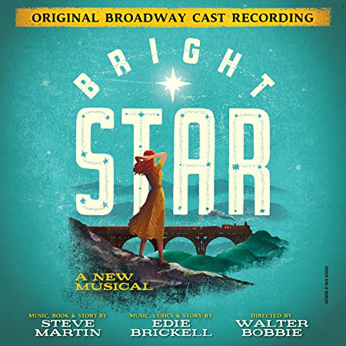
Music Examples
100 1_ Martin, Steve, $d 1945- $e composer, $e librettist.
245 10 Bright star : $b a new musical : original Broadway cast recording / $c
music, book & story by Steve Martin ; music, lyrics & story by Edie
Brickell.
300 __ 1 audio disc (61 min.) : $b digital ; $c 4 3/4 in.
650 _0 Musicals.
655 _7 Musicals. $2 lcgft
655 _7 Original cast recordings. $2 lcgft

Slide 89
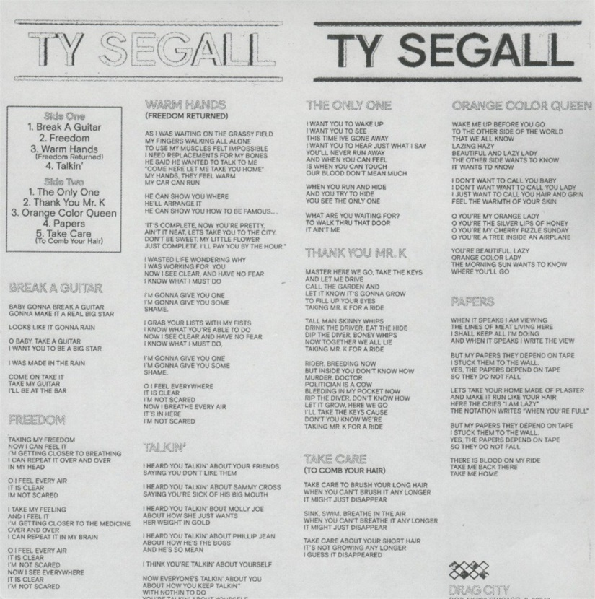
Music Examples
100 1_ Segall, Ty, $e composer, $e performer.
245 10 Ty Segall / $c Ty Segall.
264 _1 Chicago, IL : $b Drag City, $c [2017]
264 _4 $c ℗2017
300 __ 1 audio disc : $b analog, 33 1/3 rpm, stereo ; $c 12 in.
340 __ vinyl $2 rdamat
344 __ analog $2 rdatr
344 __ $c 33 1/3 rpm
344 __ $d microgroove $2 rdagw
344 __ $g stereo $2 rdacpc
511 0_ Ty Segall, guitar, vocals ; Emmett Kelly, guitar, vocals ; Mikal Cronin, bass, vocals on "Take
care" ; Charles Moothart, drums, percussion ; Ben Boye, piano, Wurlitzer.
650 _0 Garage rock music.
650 _0 Alternative rock music.
650 _0 Rock music $y 2011-2020.
655 _7 Garage rock music. $2 lcgft
655 _7 Alternative rock music. $2 lcgft
655 _7 Songs. $2 lcgft
Notes:
This is an example of a brand new recording issued on vinyl, which is still very popular and even growing in popularity again.

Slide 90
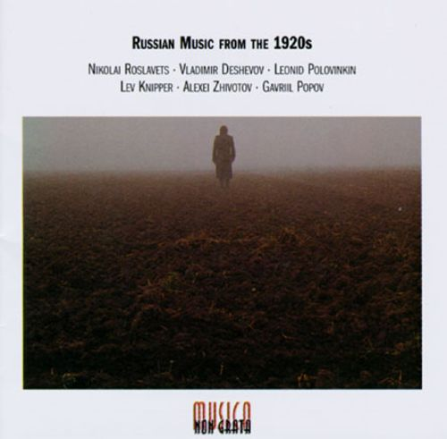
Music Examples
245 00 Russian music from the 1920s.
505 0_ Nocturne / Nikolai Roslavets (7:18) -- Rails : op. 16 / Vladimir Deshevov (1:05) -- Suite for 2 pianos. March ; Waltz ;
Humoresque / Leonid Polovinkin (9:58) -- Concerto for bassoon and strings / Lev Knipper (17:47) -- Fragments : for
nonet, op. 2 / Alexei Zhivotov (7:43) – Chamber symphony in C major, op. 2 / Gavril Popov (32:32).
650 _0 Quintets (Harp, oboe, violas (2), cello)
650 _0 Piano music.
650 _0 Piano music (Pianos (2))
650 _0 Suites (Pianos (2))
650 _0 Concertos (Bassoon with string orchestra)
650 _0 Nonets (Piano, bassoon, clarinet, flute, trombone, violins (2), viola, cello)
650 _0 Symphonies (Instrumental ensemble)
650 _0 Septets (Bassoon, clarinet, flute, trumpet, violin, cello, double bass)
650 _0 Music $z Russia $y 20th century.
655 _7 Art music. $2 lcgft
655 _7 Chamber music. $2 lcgft
655 _7 Suites. $2 lcgft
655 _7 Concertos. $2 lcgft
655 _7 Symphonies. $2 lcgft
Notes:
Note: one could use $3 in the 655s to specify which pieces are which genre/form.

Slide 91
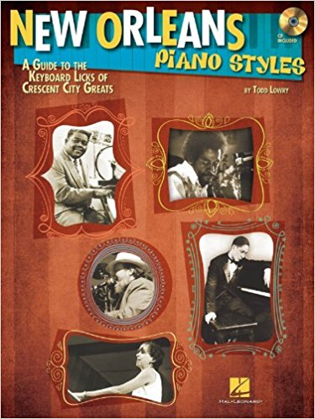
Music Examples
100 1_ Lowry, Todd, $e composer, $e author.
245 10 New Orleans piano styles : $b a guide to the keyboard licks of Crescent City
greats / $c by Todd Lowry.
__ 1 score (77 pages) : $b illustrations ; $c 31 cm + $e 1 audio disc (4 3/4 in.)
348 __ score $2 rdafnm
500 __ Accompanying CD contains demonstrations of all the musical examples in the book
as recorded by Brent Edstrom.
500 __ "Learn to play the piano styles of Jelly Roll Morton, James Booker, Fats Domino,
Professor Longhair, Allen Toussaint, Harry Connick Jr., Dr. John, and more"--Page 4
of cover.
650 _0 Piano $v Methods (Jazz)
650 _0 Piano $v Methods (Jazz) $v Self-instruction.
650 _0 Jazz $z Louisiana $z New Orleans.
655 _7 Jazz. $2 lcgft
655 _7 Methods (Music) $2 lcgft
655 _7 Scores. $2 lcgft

Slide 92
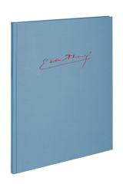
Music Examples
100 1_ Fauré, Gabriel, $d 1845-1924, $e composer.
240 10 Instrumental music. $k Selections
245 10 Berceuse pour violon et orchestre, op. 16, N 50b ; $b Ballade pour piano et orchestre, op. 19, N 56b ;
Élégie pour violoncelle et orchestre, op 24, N 66b ; Romance pour violon et orchestre, op. 28, N 71b ;
Fantaisie pour piano et orchestre, op. 111, N 184b ; Concerto pour violon et orchestre, op. 14, N 47 /
$c Gabriel Fauré ; éditées par Peter Jost.
300 __ 1 score (lxii, 278 pages) : facsimiles ; $c 33 cm.
500 __ The 1st and 4th works originally for violin and piano; the 3rd work originally for cello and piano.
650 _0 Violin with orchestra, Arranged $v Scores.
650 _0 Ballades (Instrumental music) $v Scores.
650 _0 Piano with orchestra $v Scores.
650 _0 Cello with orchestra, Arranged $v Scores.
650 _0 Concertos (Violin) $v Scores.
655 _7 Art music. $2 lcgft
655 _7 $3 1st, 3rd-4th works: $a Arrangements (Music) $2 lcgft
655 _7 $3 2nd work: $a Ballades (Instrumental music) $2 lcgft
655 _7 $3 6th work: $a Concertos. $2 lcgft
655 _7 Scores. $2 lcgft

Slide 93
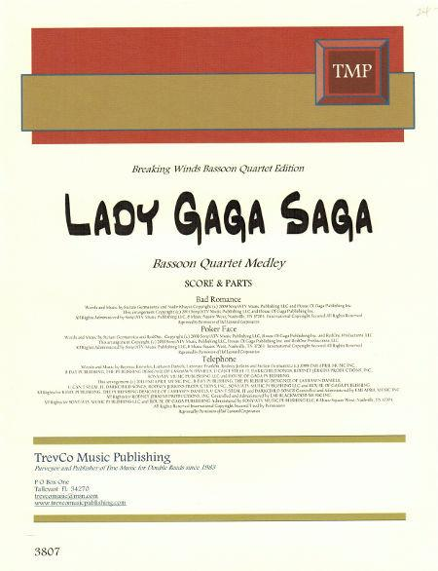
Music Examples
245 00 Lady Gaga saga : $b bassoon quartet medley.
300 __ 1 score (8 pages) + 4 parts ; $c 28 cm.
348 __ score $a part $2 rdafnm
500 __ A medley of songs made famous by Lady Gaga, including "Telephone,“
"Poker face," and "Bad romance," arranged for bassoon quartet.
650 _0 Woodwind quartets (Bassoons (4)), Arranged $v Scores and parts.
655 _7 Popular music. $2 lcgft
655 _7 Chamber music. $2 lcgft
655 _7 Medleys (Music) $2 lcgft
655 _7 Arrangements (Music) $2 lcgft
655 _7 Scores. $2 lcgft
655 _7 Parts (Music) $2 lcgft

Slide 94
Cartographic Materials
LCGFT Manual: No separate instruction sheet for these materials
Cartographic Resources Manual (2016) available through Cataloger’s Desktop
Replaces LC’s Map Cataloging Manual
Chapter 4. Subject Access:
Assign at least one genre form heading for all cartographic materials. Assign a more specific applicable heading or headings in preference to a general one, that is, Road maps rather than Maps.
There is no set order for genre form headings for maps.
However, for other cartographic materials, the first heading should be specific to the medium, such as Atlases, World atlases, Globes, or Relief models. This heading can then be followed, in no set order, by any another headings that apply, such as Physical maps or Road maps.

Slide 95
Cartographic Materials
Cartographic Resources Manual (2016) available through Cataloger’s Desktop
Chapter 4. Subject Access:
A subsidiary map mentioned in a title, subtitle, or cover, even if not indexed, frequently receives a subject or genre/form tracing depending on prominence, detail, typography, or other factors.
Subsidiary maps, especially insets, which portray a specific subject frequently receive subject or genre/form tracings, whether or not they are indexed.
The genre/form headings Maps, Tourist maps, and Road maps are all considered general headings, and the maps to which they apply are considered general maps. The use of two of the three general headings on the same work should be explained by the title, alternate title, series, or overall publishers’ intent, often clarified by a shows note.
Title: Tourist map of Britain. Title: Tourist road map of Britain.
Subject heading: Great Britain--Maps. Subject headings: Great Britain--Maps.
Genre/form heading: Tourist maps. Roads--Great Britain--Maps.
Genre/form headings: Tourist maps; Road maps
Notes:
See the Special Applications and Instructions section of chapter 4 of Cartographic Resources Manual for additional instructions on special kinds of cartographic resources.

Slide 96
Cartographic Examples
110 2_ Replogle Globes, $e cartographer.
245 10 Replogle world nation series 12 inch diameter globe / $c LeRoy
M. Tolman, chief cartographer ; Terrence E. Donovan, cartographer.
255 __ Scale 1:41,849,600. 660 miles per in. $c (W 180°--E 180°/N 90°--S
90°).
__ 1 globe : $b color, plastic coated paper gores over plastic core,
mounted on spindle crowned by a plastic clockface, in a metal
meridian half circle, on metal base ; $c 31 cm in diameter
500 __ Raised relief globe.
651 _0 Earth (Planet) $v Maps.
655 _7 Globes. $2 lcgft
655 _7 Relief models. $2 lcgft
655 _7 World maps. $2 lcgft

Slide 97
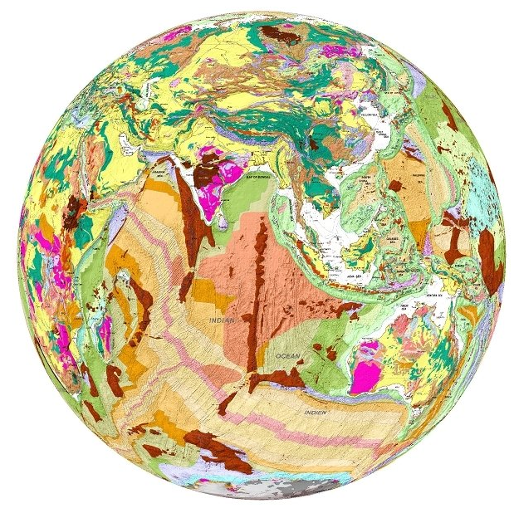
Cartographic Examples
110 2_ Real World Globes, $e cartographer.
245 10 Geological globe of the world = $b Globe géologique du monde / $c Real
World Globes.
246 31 Globe géologique du monde
255 __ Scale 1:27,900,000. 1 cm to 279 km.
300 __ 1 globe : $b color plastic-coated paper over foam core, mounted on
separate ring stand ; $c 46 cm in diameter + $e legend sheet (31 x 61 cm)
and measuring tape
650 _0 Geology $v Maps.
651 _0 Earth (Planet) $v Maps.
655 _7 Globes. $2 lcgft
655 _7 Geological maps. $2 lcgft
655 _7 World maps. $2 lcgft

Slide 98
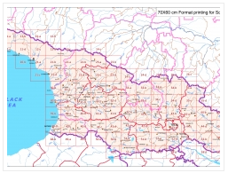
Cartographic Examples
110 2_ GeoLand Ltd., $e cartographer.
245 10 Georgia--topographical map 1:50 000 / $c GeoLand.
255 __ Scale 1:50,000 $c (E 39°52ʹ--E 46°45ʹ/N 43°51ʹ--N 41°17ʹ).
300 __ 100 maps : $b color ; $c 58 x 69 cm
500 __ General-content topographic quadrangle maps of the Republic of
Georgia also showing points-of-interest and foreign occupation zones.
__ Relief shown by contours and spot heights; relief shown by contours,
shading, spot heights, and rock drawings on some sheets.
651 _0 Georgia (Republic) $v Maps.
650 _0 Military occupation $v Maps.
655 _7 Topographic maps. $2 lcgft
655 _7 Quadrangle maps. $2 lcgft

Slide 99
Cartographic Examples
110 2_ Oxford University Press. $b Cartographic
Department, $e cartographer.
245 10 Oxford school atlas for Pakistan / $c all maps
drawn by the Cartographic Unit, Oxford University
Press, UK ; editorial advisor, Dr. Fazle Karim Khan.
__ Scales differ.
264 _1 Karachi, Pakistan : $b Oxford University Press, $c [2013]
300 __ 1 atlas (112 pages) : $b color illustrations, color maps ; $c 29 cm
651 _0 Pakistan $v Maps.
650 _0 Atlases $z Pakistan.
655 _7 Children's atlases. $2 lcgft
655 _7 World atlases. $2 lcgft

Slide 100
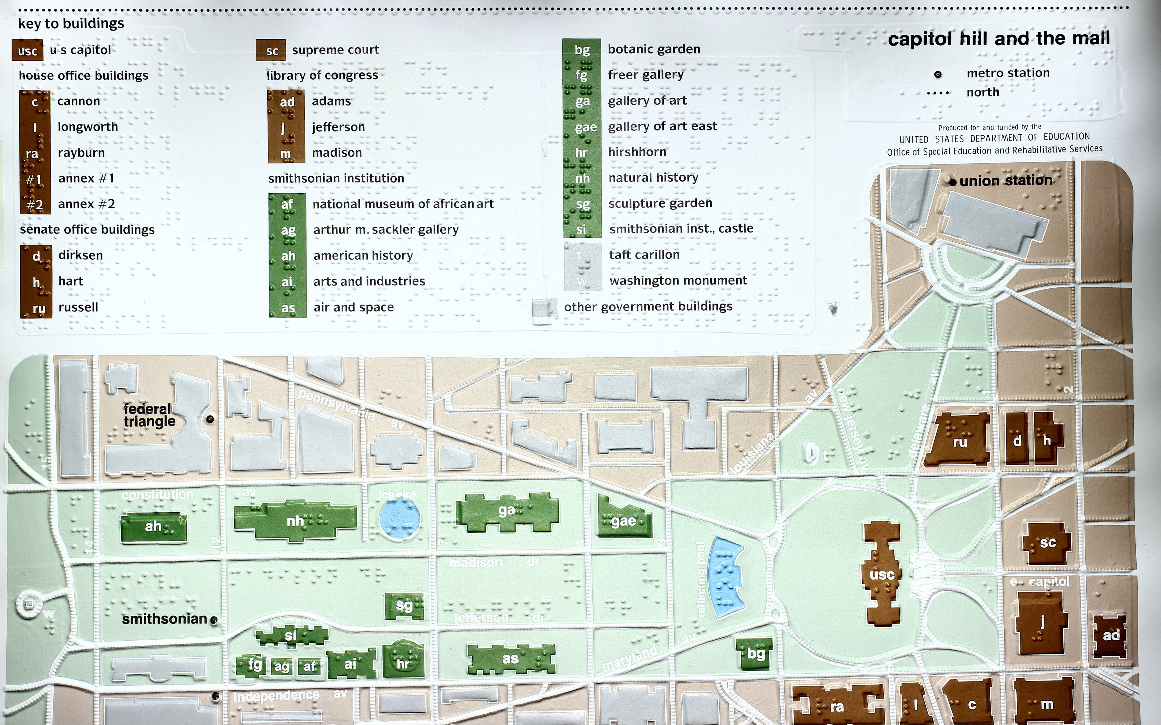
100 1_ Wiedel, Joseph W., $e cartographer.
245 10 Capitol Hill and the Mall / $c J.W.
Wiedel, Univ. of Md. ; produced for and
funded by the United States Department
of Education, Office of Special Education
and Rehabilitative Services.
500 __ Tactile map for the blind.
500 __ Covers the Mall west of the
Washington Monument.
500 __ Place-names in braille and lower-
case type.
500 __ Streets and government buildings in
raised relief.
651 _0 Capitol Hill (Washington, D.C.) $v
Maps.
651 _0 Mall, The (Washington, D.C.) $v
Maps.
650 _0 Public buildings $z Washington
(D.C.) $v Maps.
655 _7 Maps. $2 lcgft
655 _7 Cartographic materials for people
with visual disabilities. $2 lcgft
Cartographic Examples
Notes:
The LCGFT term Cartographic materials for people with visual disabilities is one of those exceptional terms that includes an audience. It’s possible that in the future these will be cancelled or changed to some other form, such as Tactile cartographic materials.

Slide 101
LCDGT
Library of Congress Demographic Group Terms

Slide 102
Audience and Creator/Contributor Characteristics
Explicit indications of audience and creators/contributors of works and expressions are out of scope for LCGFT (although currently there are a few exceptions)
If we stop using LCSH to describe what resources are, this information needs to be retained somewhere
LCSH: Almanacs, Children's LCSH: Young adult fiction, Korean
LCGFT: Almanacs LCGFT: Fiction (or Novels, Short stories, etc.)
LCSH: Jazz $z Lithuania LCSH: Music by African American composers
LCGFT: Jazz LCGFT: Music (or more specific terms)
LCSH: Music for the blind LCSH: Japanese essays $x Women authors
LCGFT: Music (or more specific terms) LCGFT: Essays
Notes:
From the Introduction to Library of Congress Demographic Group Terms:
“When LCGFT is fully implemented, LCSH form headings – including those that include both form and audience, or form and creator/contributor characteristics – will no longer be assigned to resources that are for particular audiences, or by members of a particular demographic group. Those headings will be reserved for topical resources about those resources.”

Slide 103
Audience and Creator/Contributor Characteristics
MARC fields 385 and 386 were developed to have a place to record audience and creator/contributor characteristics
Library of Congress Demographic Group Terms (LCDGT) is a controlled vocabulary specific to demographic groups and was developed for use in 385 and 386 fields
Initial group of 387 terms were approved in 2015, and there were 1,177 approved terms as of February 2018
SACO proposals: moratorium while LC does a thorough evaluation of LCDGT’s structure and principles
LCDGT should be used with the Demographic Group Terms Manual (https://www.loc.gov/aba/publications/FreeLCDGT/freelcdgt.html)
Notes:
LC distributed this notice in February 2018:
February 5, 2018
Phase 3 of the development of Library of Congress Demographic Group Terms (LCDGT) is now ended because sufficient proposals have been received to allow a thorough evaluation of LCDGT’s structure and principles. Additional proposals for new and revised demographic group terms will not be accepted until further notice.
LCDGT is intended to describe the creators of, and contributors to, resources, and also the intended audience of resources. Terms may be assigned in bibliographic records and in authority records for works and expressions.
The development of the pilot vocabulary has been undertaken in phases. During phases 1 and 2, specialists in the Policy and Standards Division (PSD) of the Library of Congress made proposals that were chiefly intended to test theories on policies, highlight specific areas of concern (e.g., conflict situations; hierarchies), provide useful examples, and serve as the basis for future development. During Phase 3, which began in January 2016, PSD accepted proposals for new and revised terms needed in new cataloging and thereby tested policies for proposing demographic group terms.
Questions and comments about LCDGT may be directed to Janis L. Young at jayo@loc.gov.

Slide 104
MARC 385 – Audience Characteristics
Indicators both blank
Subfields:
$a – Audience term (R)
$b – Audience code (R)
$m – Demographic group term (NR)
$n – Demographic group code (NR)
$0 – Authority record control number or standard number (R)
$2 – Source (NR)
$3 – Materials specified (NR)
Notes:
Field Definition and Scope
A category of persons for which a resource is intended or a category of persons representing the intellectual level for which the content of a resource is considered appropriate.
If a demographic group is not specified then multiple audience characteristics from the same source vocabulary or code list may be recorded in the same field in separate occurrences of subfield $a and subfield $b. If a demographic group is specified then the characteristics in the field must all come from the same group. Terms from different source vocabularies are recorded in separate occurrences of the field.

Slide 105
MARC 386 – Creator/Contributor Characteristics
Indicators both blank
Subfields:
$a – Creator/contributor term (R)
$b – Creator/contributor term code (R)
$i – Relationship information (R)
$m – Demographic group term (NR)
$n – Demographic group code (NR)
$0 – Authority record control number or standard number (R)
$2 – Source (NR)
$3 – Materials specified (NR)
$4 – Relationship (R)
Notes:
Field Definition and Scope
A group category to which the creator(s) of a work or compilation of works, or the contributor(s) to an expression or compilation of expressions, belongs.
If a demographic group is not specified then multiple creator/contributor group categories from the same source vocabulary or code list may be recorded in the same field in separate occurrences of subfield $a and subfield $b. If a demographic group is specified then the categories in the field must all come from the same group. Terms from different source vocabularies are recorded in separate occurrences of the field.

Slide 106
MARC 385/386 $m and $n
$m – Demographic group term (NR)
$n – Demographic group code (NR)
During the development of the 385 and 386 fields, some commented that many class of persons headings belong to broader group categories that users might want to search or limit by. For example, children, tweens, teenagers, young adults, middle-aged persons, and senior citizens are all examples of age groups. Catholics, Baptists, Jews, Buddhists, Mormons, Muslims, Hindus, and Wiccans are all examples of religious groups.
LC PSD maintains the list of group terms and codes: http://www.loc.gov/standards/valuelist/lcdgt.html

Slide 107
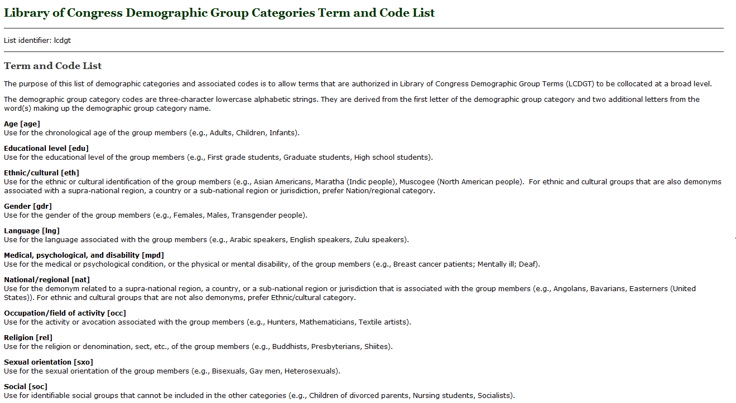
http://www.loc.gov/standards/valuelist/lcdgt.html

Slide 108
385/386 Fields
$m and $n are optional
$2 is optional, but recommended if terms recorded are from a controlled vocabulary. Use lcdgt for terms from LCDGT
May repeat $a when terms are from the same vocabulary:
386 __ Catholics $a Canadians $a Librarians $2 lcdgt
A work or works created by Catholic Canadian librarians
Must repeat the field if $m or $n is used and terms belong to different demographic categories:
386 __ $n rel $a Catholics $2 lcdgt
386 __ $n nat $a Canadians $2 lcdgt
386 __ $n occ $a Librarians $2 lcdgt

Slide 109
385/386 Fields
Must repeat field if terms are from different controlled vocabularies:
385 __ Teenagers $2 lcdgt
385 __ Adolescents $2 ericd
A work or works for teenagers
386 __ Indians, North American $2 mesh
386 __ American Indians $2 ericd
386 __ Indians of North America $2 lcsh
A work or works created by Native Americans
Notes:
Note: There currently is no collective term in LCDGT for Native Americans

Slide 110
385/386 Fields
Generally, break up compound terms into their components. For example:
386 __ Japanese American women teachers $2 lcsh
use instead:
386 __ Japanese Americans $a Women $a Teachers $2 lcdgt
or
386 __ Japanese Americans $2 lcdgt
386 __ Women $2 lcdgt
386 __ Teachers $2 lcdgt
A work or works created by Japanese American women teachers

Slide 111
386 Field
$i (Relationship information) and $4 (Relationship) can be used to record relationship of the term(s) recorded and the resource described
100 1_ Bolton, Chris A., $e author.
245 10 Smash. $p Trial by fire / $c written by Chris A. Bolton ; art by Kyle Bolton.
385 __ Children $2 lcdgt
385 __ Middle school students $2 lcdgt
386 __ $i Author: $a Washingtonians (Washington State)
$2 lcdgt
386 __ $i Artist: $a Oregonians $2 lcdgt
386 __ $i Author, $i Artist: $a Brothers $2 lcdgt
655 _7 Superhero comics. $2 lcgft
655 _7 Graphic novels. $2 lcgft
700 1_ Bolton, Kyle, $e artist.
Notes:
$i - Relationship information
Designation of a relationship between one or more members of the demographic group recorded in the 386 field and the resource described in the 1XX/245 of the record. This may be an uncontrolled textual phrase or a controlled textual value from a list of relationships between bibliographic resources.
This example is a graphic novel for middle school students by two brothers, one of whom lives in Washington State and the other who lives in Oregon. The subfield $i can be used to distinguish the role of the persons with each demographic group term recorded.

Slide 112
386 Field
$i (Relationship information) and $4 (Relationship) can be used to record relationship of the term(s) recorded and the resource described
100 1_ Messiaen, Olivier, $d 1908-1992, $e composer.
245 10 Turangalîla-symphonie / $c Messiaen.
511 0_ Pierre-Laurent Aimard, piano ; Dominique Kim, ondes Martenot ;
Berliner Philharmoniker ; Kent Nagano, conductor.
386 __ $i Composer: $a French $2 lcdgt
386 __ $i Instrumentalist (piano): $a French $2 lcdgt
386 __ $i Instrumentalist (ondes Martenot): $a South Koreans $2 lcdgt
386 __ $i Performer: $a Germans $2 lcdgt
386 __ $i Conductor: $a Americans $a Japanese Americans $a Sanseis $2 lcdgt
Notes:
$i - Relationship information
Designation of a relationship between one or more members of the demographic group recorded in the 386 field and the resource described in the 1XX/245 of the record. This may be an uncontrolled textual phrase or a controlled textual value from a list of relationships between bibliographic resources.
If gender was important, it could be included as another subfield $a in the 386 fields, the 386 fields could be doubled, or the $i could be repeated:
386 __ $i Composer $i Instrumentalist (piano) $i Conductor: $a Men $2 lcdgt
386 __ $i Instrumentalist (ondes Martenot): $a Women $2 lcdgt
Sanseis: third generation Japanese-Americans

Slide 113
386 Field
$i (Relationship information) and $4 (Relationship) can be used to record relationship of the term(s) recorded and the resource described
130 0_ Gravity (Motion picture : 2013)
245 10 Gravity / $c directed by Alfonso Cuarón ; written by Alfonso
Cuarón & Jonás Cuarón ; produced by Alfonso Cuarón ; produced
by David Heyman ; executive producers, Nikki Penny, Chris
DeFaria, Stephen Jones ; a Warner Bros. Pictures presentation ; an
Esperanto Filmoj produktado ; a Heyday Films production ; an
Alfonso Cuarón film.
257 __ United States $a Great Britain $2 naf
386 __ $4 http://id.loc.gov/vocabulary/relators/fmd $i Film director: $a
Mexicans $a Men $2 lcdgt
Notes:
$4 - Relationship
Code or URI that specifies the relationship from the entity described in the record to the entity referenced in the field.

Slide 114
386 Field
$3 can be used to specify what part(s) the term(s) apply to
245 00 Five romantic plays, 1768-1821 / $c edited by Paul Baines, Edward Burns.
386 __ Britons $2 lcdgt
386 __ $3 The mysterious mother ; Wat Tyler ; Lovers' vows ; The two Foscari $a
English $2 lcdgt
386 __ $3 De Monfort $a Scots $2 lcdgt
386 __ $3 The mysterious mother ; Wat Tyler ; The two Foscari $a Men $2 lcdgt
386 __ $3 De Monfort ; Lovers' vows $a Women $2 lcdgt
505 00 $t The mysterious mother / $r Horace Walpole -- $t Wat Tyler / $r Robert
Southey -- $t De Monfort / $r Joanna Baillie -- $t Lovers' vows / $r
Elizabeth Inchbald -- $t The two Foscari / $r Lord Byron.
Notes:
$3 - Materials specified
Part of the described materials to which the field applies.
In the example, all of the plays are by British authors. Four are by English authors and one is by a Scot. Three are by men and two by women.

Slide 115
386 Field
$3 can be used to specify what part(s) the term(s) apply to
245 00 Folia.
386 __ $3 Woodwind quintet ; Jeu de cinq ; Folia $i Composer: $a
Canadians $2 lcdgt
386 __ $3 Quintessant $i Composer: $a Americans $2 lcdgt
386 __ $3 Jeu de cinq $i Composer: $a Swedish Canadians $2 lcdgt
386 __ $i Composer: $a Men $2 lcdgt
386 __ $i Performer: $a Canadians $2 lcdgt
511 0_ York Winds.
505 0_ Woodwind quintet / Brian Cherney (9:15) -- Jeu de cinq / Bengt
Hambraeus (14:40) -- Quintessant / Norman Sherman (15:20) --
Folia / Robert Aitken (10:33).
Notes:
$3 - Materials specified
Part of the described materials to which the field applies.
This example shows the use of $3 in combination with $i. A sound recording of wind quintets performed by the York Winds. All of the compositions are by men. Three are by Canadians and one by an American. One of the works by Canadians is by a Swedish Canadian.

Slide 116
Which Vocabularies to Use?
Any vocabularies that are on the Subject Heading and Term Source Codes list or other appropriate specialized lists such as Occupation Term Source Codes
LCDGT is being developed as a preferred vocabulary to use in these fields
My advice:
1) use LCDGT as first choice
2) propose needed new terms through SACO whenever possible
3) use other vocabularies (LCSH, MeSH, AAT, etc.) as third resort
4) use uncontrolled or locally maintained terms as last resort
http://www.loc.gov/standards/sourcelist/subject.html

Slide 117
Where Can You Find LCDGT Terms?
Available in Classification Web and through LC’s Linked Data Service (id.loc.gov)
Now also searchable through Cataloger’s Desktop (if you have a Class Web subscription)
Annually created PDF file at https://www.loc.gov/aba/publications/FreeLCDGT/DEMOGRAPHIC.pdf
Netanel Ganin’s list at http://www.netanelganin.com/projects/lcdgt/lcdgt.html
New and changed terms are posted in the monthly lists at http://www.loc.gov/aba/cataloging/subject/weeklylists; free subscriptions to the monthly lists, via e-mail or RSS feed, can be arranged at http://www.loc.gov/rss
Full MARC 21 authority records in MARC UTF-8 format are free to download from http://classificationweb.net/LCDGT/ and in a variety of formats from the Linked Data Service
Authority records not available in OCLC Connexion or SkyRiver
Notes:
The primary source for access to the approved LCDGT terms is Classification Web. The terms can now also be searched in Cataloger’s Desktop if you also have a Classification Web subscription. There is a PDF file compiled annually posted on the LCDGT Manual web page. Authority records in MARC UTF-8 format may be freely downloaded from http://classificationweb.net/LCDGT/, and they are also available for download in a variety of formats from LC’s Linked Data Service, http://id.loc.gov. Hopefully, with enough interest, people will convince OCLC to make the terms available through Connexion, so you can search the authorities there.

Slide 118
LCDGT Authority Record
Authorized terms are tagged 150 even though they are used in 3XX fields
010 has prefix “dg” and 040 $f “lcdgt”
072 field contains code(s) for the demographic group categories a term falls into
072 code “eth” indicates that the established term Bosnian Swedes is an ethnic/cultural group

Slide 119
Why Use LCDGT?
LCDGT includes many terms that are not in LCSH:
language speakers Chinese speakers Korean speakers
demonyms for persons from states, provinces, regions, etc.
Wisconsinites Newfoundlanders Tuscans
non-U.S. ethnic groups formed as compound terms
Japanese Canadians Asian Australians Bosnian Swedes
members of named religious denominations and political parties
Church of Scotland members Fianna Fáil members (Ireland)
LCDGT terms may be different from LCSH:
phrase headings instead of [Main heading]--[Subdivision] strings
Breast cancer patients Bookstore employees
Native American tribal groups formed differently
Cherokee (North American people) vs. Cherokee Indians
new authority research might lead to choice of different authorized form
Notes:
In LCSH some class of persons headings are formed by adding subdivisions to a main heading:
Breast $x Cancer $x Patients
Bookstores $x Employees
There are no subdivided terms in LCDGT. All terms are formed in direct order as plural nouns.
Terms for Native American tribes are formed the same way in LCDGT as they are for other groups around the world. The term for the tribe or ethnic group is qualified by a qualifier in the form “([demonym] people)”. Hence “Cherokee (North American people)” and “Basques (European people)” and “Bengali (South Asian people)”. This provides consistency throughout the vocabulary and is less North American-centric.

Slide 120
Notes:
LCDGT via Classification Web

Slide 121
Searching by “Subject heading” will result in a browsable list beginning with the term searched
Use the established demographic group codes in the “Subject category code” search and you will get a list of all of the established terms that are members of that demographic group
Notes:
LCDGT via Classification Web

Slide 122
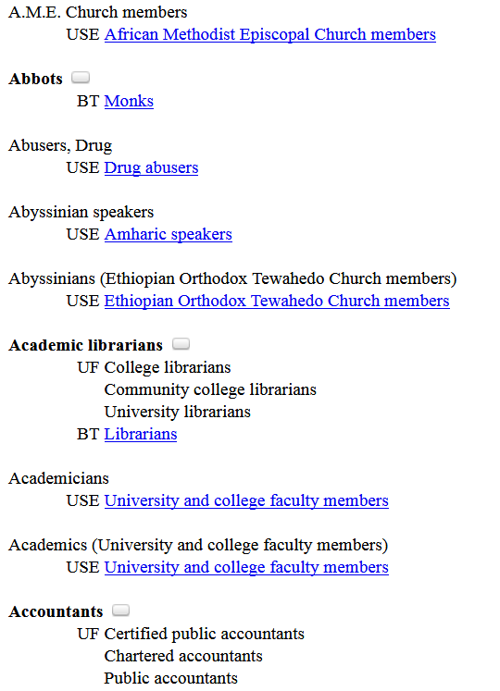
Click on bubble to view MARC record

Slide 123
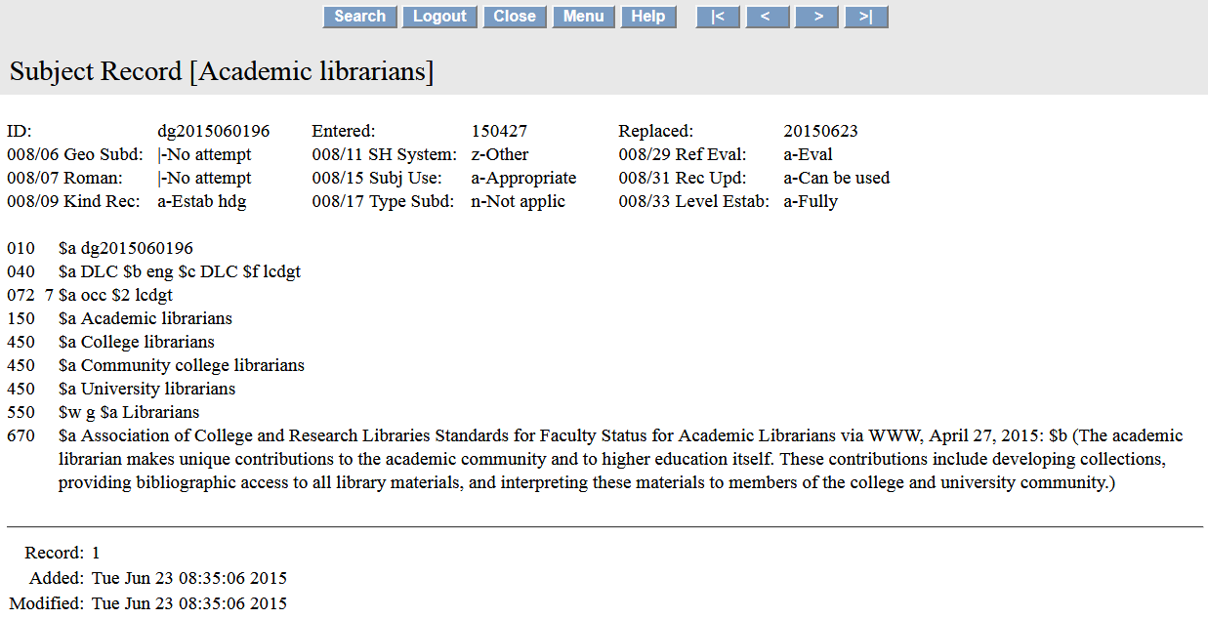
072 code indicates that the established term Academic librarians is an occupational group
Notes:
Authority record for LCDGT term Academic librarians viewed in Classification Web

Slide 124
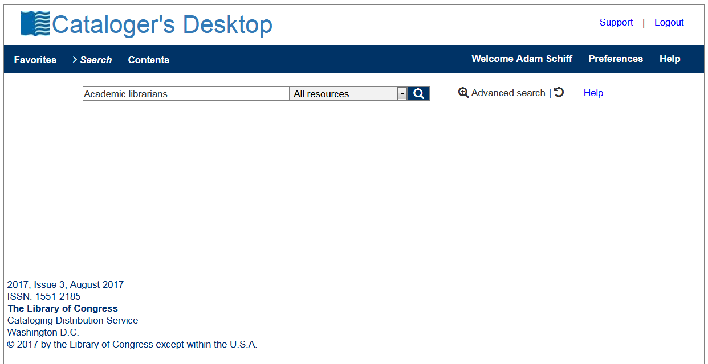
Notes:
If you have a subscription to both Classification Web and Cataloger’s Desktop, you can now search LCDGT terms through Cataloger’s Desktop.

Slide 125
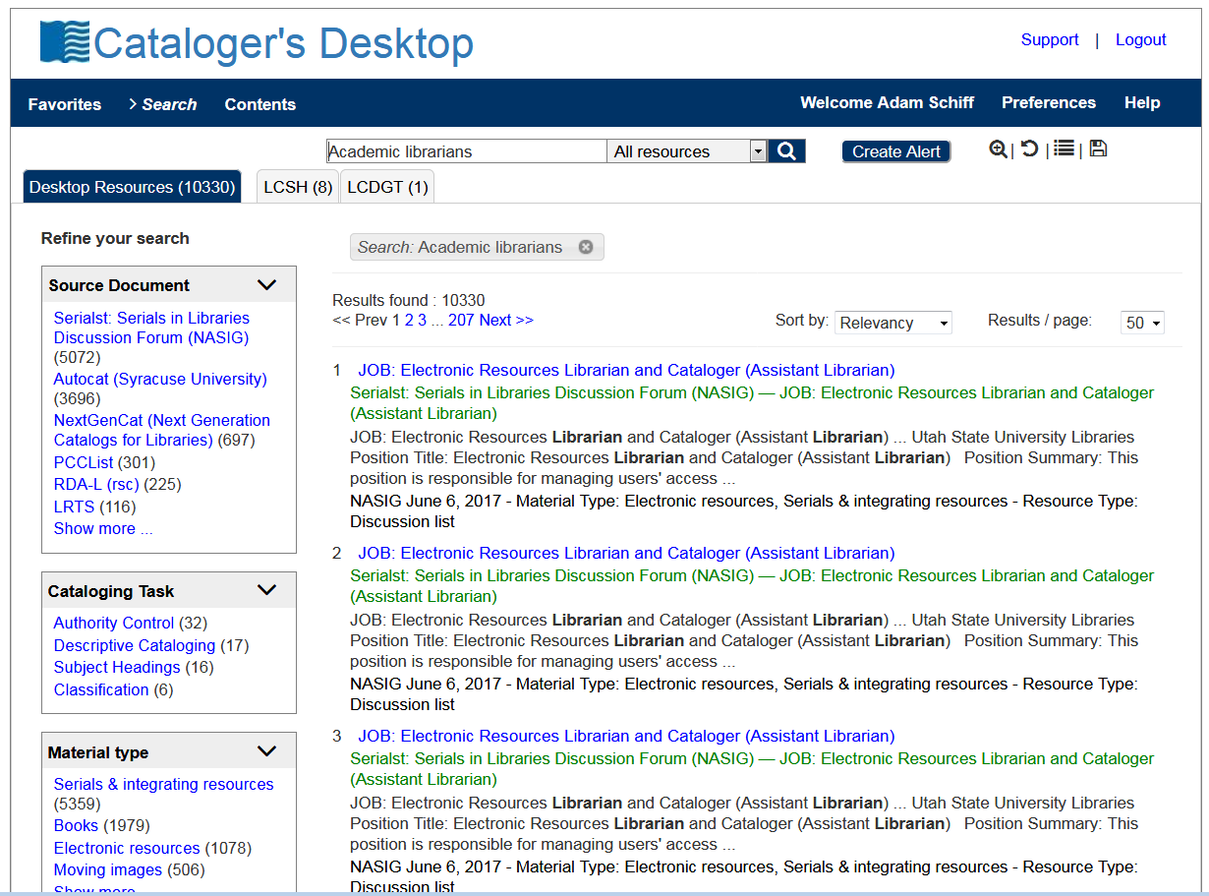
Notes:
If you have a subscription to both Classification Web and Cataloger’s Desktop, you can now search LCDGT terms through Cataloger’s Desktop.

Slide 126
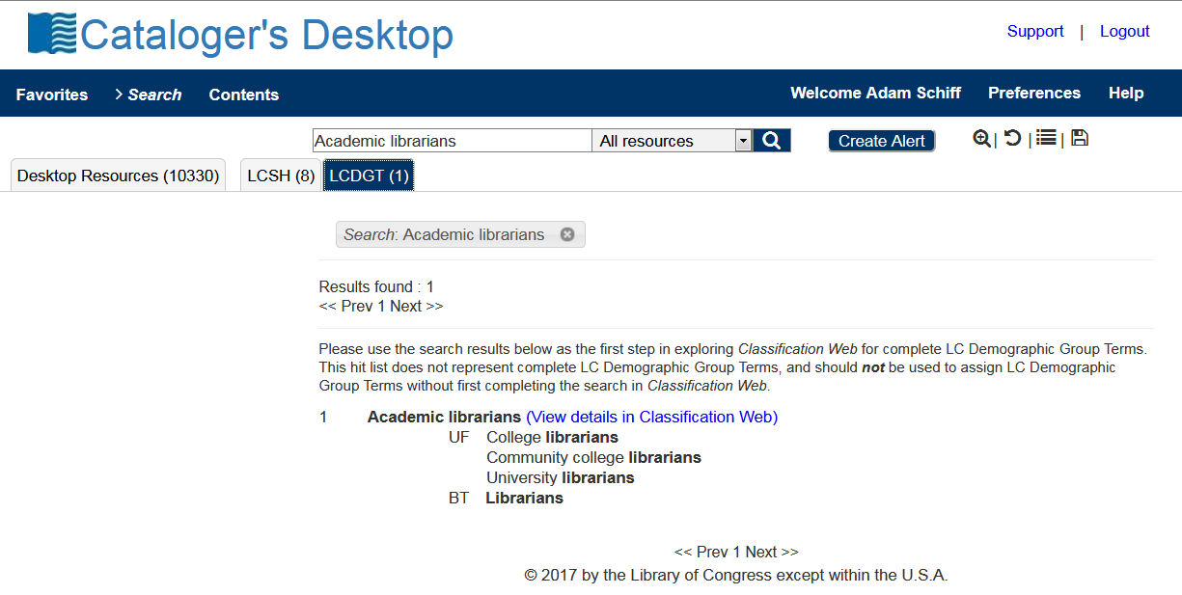

Slide 127
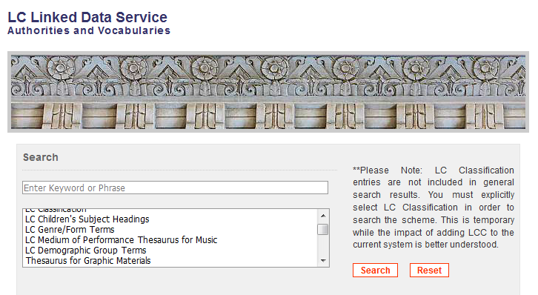
id.loc.gov
Notes:
LCDGT via the LC Linked Data Service

Slide 128
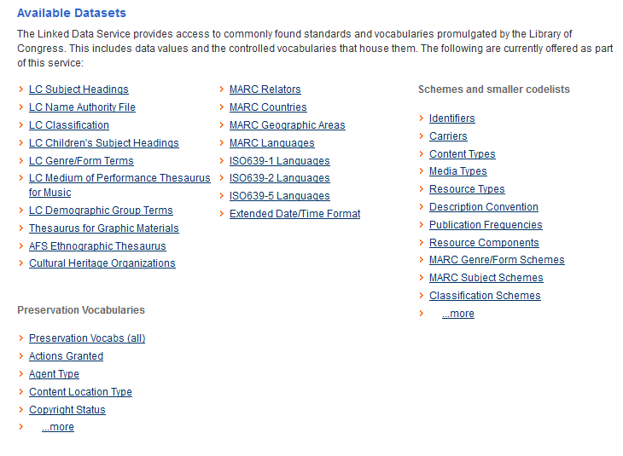

Slide 130
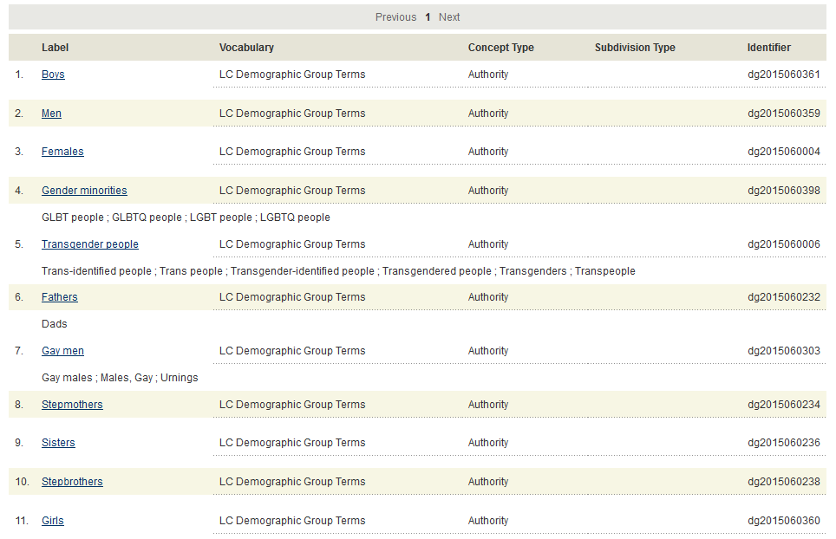
Notes:
Screen display after clicking on the Gender Group link

Slide 131
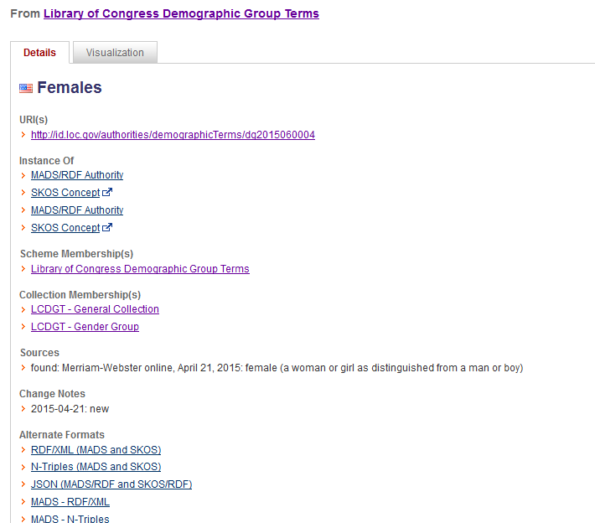

Slide 132
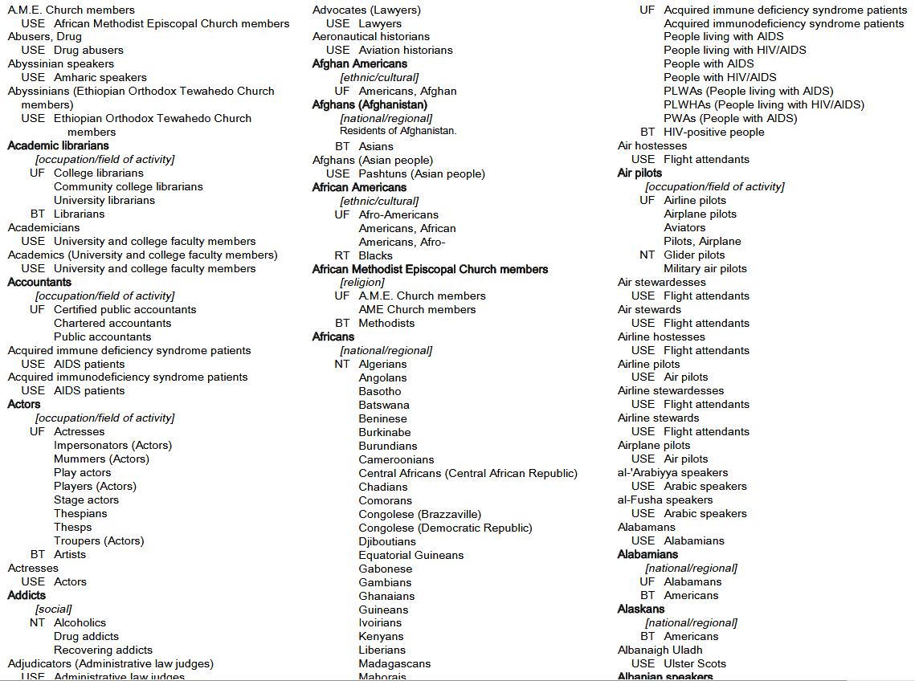
PDF file of terms on the LCDGT web page:
https://www.loc.gov/aba/publications/FreeLCDGT/freelcdgt.html
Caution: only updated annually
Notes:
PDF file of LCDGT on the LCDGT Manual website. This is only updated annually.

Slide 133
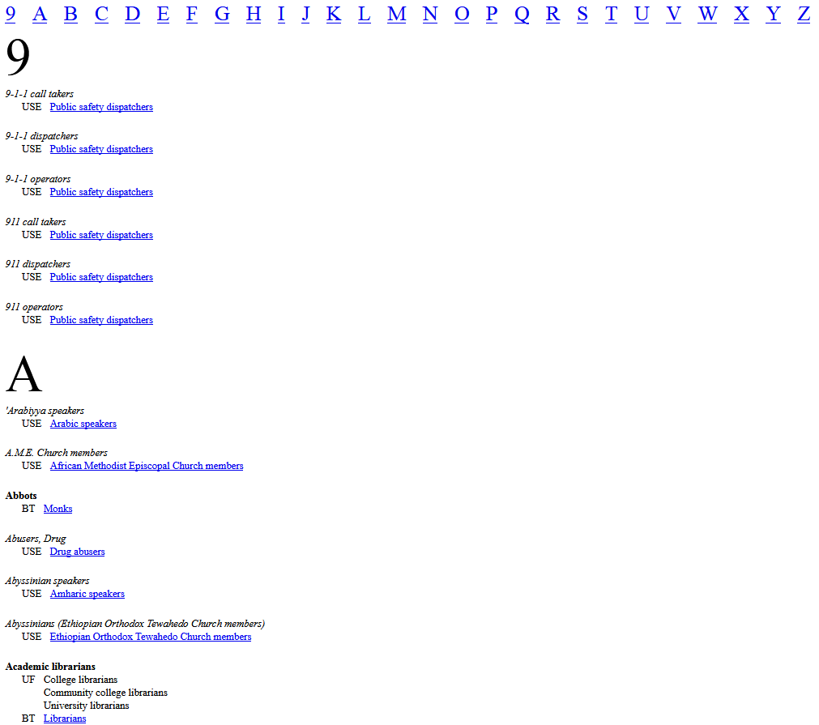
Netanel Ganin generates an up-to-date list of LCDGT monthly:
http://www.netanelganin.com/projects/lcdgt/lcdgt.html
Notes:
Netanel Ganin (former of Brandeis University, now at Library of Congress National Audio-Visual Conservation Center) is generating an alphabetical list of the terms for those who don’t have access to Classification Web.

Slide 134
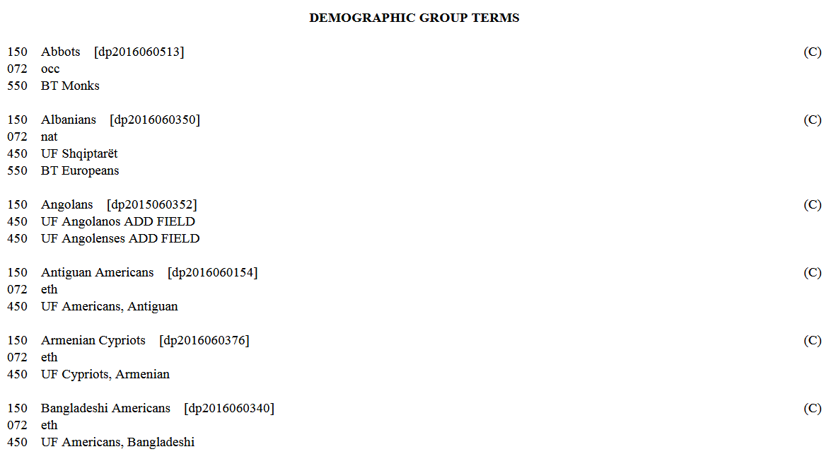
Notes:
New and changed demographic terms are published on the LC Subject Headings Monthly Lists at http://www.loc.gov/aba/cataloging/subject/weeklylists/ or https://classificationweb.net/approved-subjects/

Slide 135
Assigning LCDGT
https://www.loc.gov/aba/publications/FreeLCDGT/freelcdgt.html
Notes:
The LCDGT Manual, currently in a draft edition, is the source for guidelines and principles for assigning and establishing LCDGT terms. The manual is available in PDF form online. The final version, expected some time in 2018, will probably also be available through Cataloger’s Desktop.

Slide 136
Assigning LCDGT - Key Points
May add Audience Characteristics (field 385) and Creator/Contributor Characteristics (field 386) to bibliographic and authority records
LC practice: one term per field. Repeat field if recording multiple terms. Optionally include $n code.
385 __ Lawyers $2 lcdgt
385 __ Japanese speakers $2 lcdgt
or
385 __ $n occ $a Lawyers $2 lcdgt
385 __ $n lng $a Japanese speakers $2 lcdgt
Notes:
The Program for Cooperative Cataloging has not yet announced a particular practice or best practice.

Slide 137
Assigning LCDGT - Key Points
LCDGT Manual L 480 (Audience) and L 485 (Creators/Contributors)
Audience may be explicitly stated or implicit. Infer audience through examination of the resource (subject matter, format, etc.).
Liberally assign inferred audiences for juvenile resources, both fiction and nonfiction. Not restricted to age and educational level terms. For example, for a picture book on intercountry adoption for ages 5-9, you could assign both School children and Adoptees, if considered useful for those wishing to find a resource to help explain adoption to young children
No limit to number of terms that can be assigned
Notes:
L 480
1. b. Implicit indication of intended Audience.
Assign one or more terms that describe the intended audience and that come readily to mind from a superficial review of the resource, including the subject matter, format, etc. Assign such terms with caution, since even resources that seem to have a relatively narrow inferred audience may be useful to a wide variety of readers, depending on the viewpoints of the readers. In case of doubt, do not include terms for audiences that are only inferred.

Slide 138
Assigning LCDGT - Key Points
LCDGT Manual L 480 (Audience) and L 485 (Creators/Contributors)
Generally, all editions of a resource should get the same audience terms assigned, unless the audience has changed significantly. Generally, all editions of a resource by the same creator should get the same creator terms.
You may assign terms that overlap in meaning if they are in different group categories (e.g., Teenagers and High school students; Asian Americans and Americans)
Creator/contributor terms should be based on self-identification as a member of a particular demographic group
Avoid assigning terms based solely on a photograph or a person’s name. Gendered titles (Ms., Mr., Madame, contessa) and pronouns (he, she, elle, er, etc.) may be used, with caution, to choose terms describing a person’s gender
Notes:
Avoid assigning terms based on a photograph or picture of the creator, or based on the creator’s name, because they can be misleading regarding age, ethnicity, gender, etc. Gendered titles such as Ms., Mr., or Dottoressa (i.e., an Italian title for a female university graduate) may be useful in assigning terms describing gender, but they must be used with caution, as must pronouns such as he, she, and their equivalents in other languages.

Slide 139
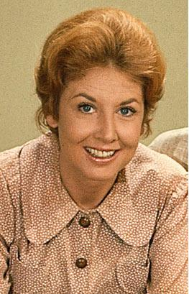
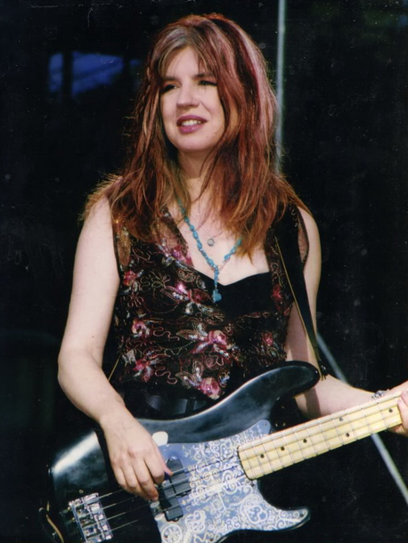
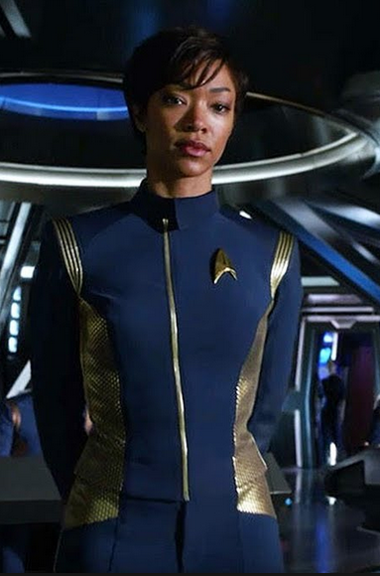
What do each of these people have in common?
Notes:
They are all named Michael.
Michael Learned, actress from the TV show The Waltons
Michael Steele, bassist and guitarist in bands such as The Bangles and The Runaways
Michael Burnham, fictional character on Star Trek: Discovery, portrayed by American actress Sonequa Martin-Green

Slide 140
Assigning LCDGT - Key Points
LCDGT Manual L 480 (Audience) and L 485 (Creators/Contributors)
Demographic terms assigned to one of a creator’s resources generally can be used on other resources created by the same person
Assign a term that is broader or more general than the group it is intended to cover only when it is not possible to establish a precise term, or when an array of terms is needed
Assign a separate term for each discrete element rather than compound terms (e.g., Japanese Americans and Women and Teachers, rather than the LCSH term Japanese American women teachers)
L 487 gives guidance on the order of the terms
If classification number does not reflect either the audience or creator/contributor characteristics, the order doesn’t matter

Slide 141
Assigning LCDGT - Key Points
Follow special instructions in L 510-L 560 if there are any
Age level and Educational level terms can both be assigned
385 __ Teenagers $2 lcdgt
385 __ Junior high school students $2 lcdgt
385 __ High school students $2 lcdgt
Assign Adults only when resource specifically states that as the audience. This can include statements found on a resource such as “Ages 10 and up”:
385 __ Preteens $2 lcdgt
385 __ Teenagers $2 lcdgt
385 __ Adults $2 lcdgt
Many resources may not have a specific audience and that’s OK. Resources with a general audience do not get any audience terms assigned.

Slide 142
Assigning LCDGT - Key Points
Follow special instructions in L 510-L 560 if there are any
Ethnic/cultural terms and nationality/regional terms may both be assigned, even if they share wording (e.g., Korean Americans and Americans)
Assign demonyms based on statements that indicate current or former residence in a place
Do not attempt to distinguish between people who were born and/or grew up in a place and those who moved to that place later in their lives. Do not attempt to discern immigration and naturalization status, except as explicitly indicated on the resource itself.
“… was born and raised in Australia and currently lives in Spain”
386 __ Australians $a Spaniards $2 lcdgt

Slide 143
Assigning LCDGT - Key Points
Follow special instructions in L 510-L 560 if there are any
When the audience or creator/contributor resides below the first-level administrative subdivisions of countries (e.g., a state, a province), assign terms for the first-level administrative subdivision (e.g., for a resident of San Francisco or someone who grew up in San Francisco, assign Californians)
Note: LC is still deciding whether and how to establish demonyms for places below the first-level administrative subdivision of a country
Possible interim practice:
If there is an well known demonym for the local place, assign it without a subfield $2 or with $2 local if you keep your own list of locally assigned terms
For creator/contributors, could also add 370 $g for the place of origin of work
For example: A collection of poetry written by people from Tampa, Florida
370 __ $g Tampa (Fla.) $2 naf
386 __ Tampans or Tampans $2 local
386 __ Floridians $2 lcdgt

Slide 144
Assigning LCDGT - Key Points
Follow special instructions in L 510-L 560 if there are any
Do not assign language terms just to reflect the language of a resource (e.g., don’t assign audience German speakers to every resource in German). Language terms for audience are usually assigned for resources that instruct speakers of one language who are learning another language.
Bilingual dictionaries may have two audience speaker terms assigned if speakers of both languages would find it useful
245 00 Collins English-Italian, Italian-English dictionary …
385 __ English speakers $2 lcdgt
385 __ Italian speakers $2 lcdgt
Monolingual language dictionaries would not be assigned a language audience term, e.g., don’t assign English speakers to the OED or to A Dictionary of Economics

Slide 145
Assigning LCDGT - Key Points
Do not assign a term from the Occupation/Field of Activity category when the term is redundant with the format of resource being cataloged. That is, don’t assign Composers as a creator characteristic of a score. It’s a score, so its creator must be a composer! Similarly, don’t assign Poets to every book of poetry. However, if you have a novel or non-fiction work written by a composer, then assigning Composers as a creator characteristic is useful.
Consider SACO proposals for new LCDGT terms needed in new cataloging
Continue to follow current subject cataloging policies and procedures as found the Subject Headings Manual. That is, assignment of LCDGT in fields 385 and 386 is in addition to what you assign in 6XX fields.
Notes:
It is highly unlikely that someone will come to the reference/information desk with a question such as: “do you have any music by composers?” or “I’d like to find all of the novels you have by authors.” Therefore it is unnecessary and redundant to record a creator term that corresponds to the format of the resource being cataloged. On the other hand, users might want to know if you have any novels written by composers, or music written by poets.

Slide 146
Examples - Audience
245 00 Monsters, Inc. / $c Walt Disney Pictures presents ; Pixar Animation
Studios film ; producer, Darla K. Anderson ; written by Andrew
Stanton, Daniel Gerson ; directors, Pete Docter, David Silverman,
Lee Unkrich.
385 __ Children [or perhaps Families] $2 lcdgt
650 _0 Monsters $v Juvenile drama.
650 _0 Factories $v Juvenile drama.
650 _0 Monsters, Inc. (Imaginary organization)
$v Juvenile drama.
650 _0 Girls $v Juvenile drama.
650 _0 Toddlers $v Juvenile drama.
650 _0 Male friendship $v Juvenile drama.
650 _0 Nightmares $v Juvenile drama.
Notes:
Another possible 385 that could be useful here, especially since LCGFT does not have the term Family films:
385 Families $2 lcdgt

Slide 147
Examples - Audience
100 1_ Lowry, Todd, $e composer, $e author.
245 10 New Orleans piano styles : $b a guide to the keyboard licks of Crescent City
greats / $c by Todd Lowry.
__ 1 score (77 pages) : $b illustrations ; $c 31 cm + $e 1 audio disc (4 3/4 in.)
385 __ Piano students $2 lcdgt
500 __ Accompanying CD contains demonstrations of all the musical examples in the book
as recorded by Brent Edstrom.
500 __ "Learn to play the piano styles of Jelly Roll Morton, James Booker, Fats Domino,
Professor Longhair, Allen Toussaint, Harry Connick Jr., Dr. John, and more"--Page 4
of cover.
650 _0 Piano $v Methods (Jazz)
650 _0 Piano $v Methods (Jazz) $v Self-instruction.
650 _0 Jazz $z Louisiana $z New Orleans.
655 _7 Jazz. $2 lcgft
655 _7 Methods (Music) $2 lcgft
655 _7 Scores. $2 lcgft

Slide 148
Examples - Audience
110 2_ Oxford University Press. $b Cartographic
Department, $e cartographer.
245 10 Oxford school atlas for Pakistan / $c all maps
drawn by the Cartographic Unit, Oxford University
Press, UK ; editorial advisor, Dr. Fazle Karim Khan.
__ Scales differ.
264 _1 Karachi, Pakistan : $b Oxford University Press, $c [2013]
300 __ 1 atlas (112 pages) : $b color illustrations, color maps ; $c 29 cm
385 __ High school students $2 lcdgt
651 _0 Pakistan $v Maps.
650 _0 Atlases $z Pakistan.
655 _7 Children's atlases. $2 lcgft
655 _7 World atlases. $2 lcgft

Slide 149
Examples - Audience
245 00 Conozca Andalucia.
264 1_ San Antonio, TX : $b Babbitt Instructional Resources, $c [2013]
300 __ 1 videodisc (31 min.) : $b sound, color ; $c 4 3/4 in. + $e 1 computer disc (4 3/4 in.)
385 __ Spanish students [Term not yet in LCDGT – could be proposed]
385 __ English speakers $2 lcdgt
__ "This DVD is for advanced beginning and intermediate students. It is composed of five lessons
devoted to the history and folklore of the old province of Andalucia. The goal of this program is to
help students beginning the study of Spanish to learn about the history, art and folklore of
Andalucia while, at the same time, gain skills in the language itself"--Container.
650 _0 Spanish language $v Films for English speakers.
650 _0 Spanish language $x Study and teaching $x English speakers.
651 _0 Andalusia (Spain) $x Civilization.
651 _0 Andalusia (Spain) $x History.
650 _0 Folklore $z Spain $z Andalusia.
655 _7 Instructional films. $2 lcgft
655 _7 Nonfiction films. $2 lcgft
Notes:
Note: Spanish students is not yet established in LCDGT. If a library were cataloging this resource, they would probably want to propose this term through SACO. The omission of $2 in the first 385 field shows that the term is currently uncontrolled.

Slide 150
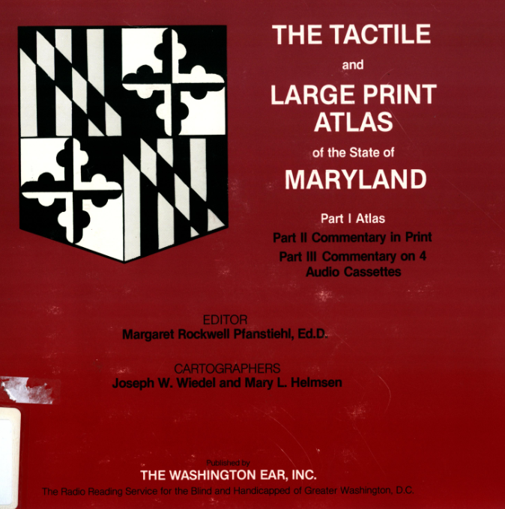
Examples - Audience
100 1_ Wiedel, Joseph W., $e cartographer.
245 14 The tactile and large print atlas of the state of Maryland / $c editor,
Margaret Rockwell Pfanstiehl, Ed.D. ; cartographers, Joseph W. Wiedel
and Mary L. Helmsen.
340 __ $n large print $2 rdafs
346 __ $b Braille code.
385 __ Blind $2 lcdgt
385 __ People with visual disabilities $2 lcsh
651 _0 Maryland $v Maps.
655 _7 Atlases. $2 lcgft
655 _7 Braille books. $2 lcgft
655 _7 Cartographic materials for people with visual disabilities. $2 lcgft
655 _0 Large type books.
Notes:
The second 385 field contains a term taken from LCSH, because the needed term was not found in LCDGT. It could be proposed for LCDGT through SACO. This atlas contains both large print and braille, so its audience is both blind persons and people with limited sight.

Slide 151
Examples - Audience
100 1_ Bruce, Hank, $e author.
245 10 Florida gardening for seniors / $c by Hank Bruce.
385 __ Gardeners $2 lcdgt
385 __ Older people $2 lcdgt
385 __ Floridians $2 lcdgt
500 __ A booklet providing gardening advice for
senior Florida gardeners.
650 _0 Gardening for older people $z Florida.

Slide 152
Examples – Creator/Contributor Characteristics
245 00 Women on the edge : $b writing from Los Angeles / $c edited by
Samantha Dunn and Julianne Ortale ; foreword by Janet Fitch.
386 __ Californians $2 lcdgt
386 __ Women $2 lcdgt
650 _0 Short stories, American $z California $z Los Angeles.
650 _0 American fiction $x Women authors.
651 _0 Los Angeles (Calif.) $v Fiction.
655 _7 Short stories. $2 lcgft
Also consider including:
386 __ Angelenos [without $2 or with $2 local]
370 __ $g Los Angeles (Calif.) $2 naf
Notes:
This is a compilation of short stories by Californian women. Currently, LC does not accept proposals for demonyms below the level of a state or province, that is, demonyms for local places like cities. There’s nothing that prevents you, however, from recording an uncontrolled term, should you decide that is important for access. Simply record the term without a subfield $2. Another option is to record the local place in the 370 subfield $g (place of origin of work or expression).
Since users looking for American short stories would probably also want to retrieve this collection, it might also be beneficial to include a 386 for Americans as well.

Slide 153
Examples – Creator/Contributor Characteristics
100 1_ Rawlings, Marjorie Kinnan, $d 1896-1953,
$e author.
245 14 The sojourner / $c Marjorie Kinnan Rawlings.
386 __ Floridians $2 lcdgt
386 __ Americans $2 lcdgt
386 __ Women $2 lcdgt
655 _7 Psychological fiction. $2 lcgft
655 _7 Domestic fiction. $2 lcgft
655 _7 Novels. $2 lcgft
Notes:
A novel by a Floridian woman author. The second 386 is not called for by the LCDGT manual, but might be useful in faceted discovery systems.

Slide 154
Examples – Creator/Contributor Characteristics
100 1_ King, Coretta Scott, $d 1927-2006, $e author.
245 10 My life, my love, my legacy / $c Coretta Scott King as told to the
Rev. Dr. Barbara Reynolds.
386 __ African Americans $2 lcdgt
386 __ Americans $2 lcdgt
386 __ Civil rights workers $2 lcsh
386 __ Activists $2 lcdgt
386 __ Baptists $2 lcdgt
386 __ Widows $2 lcdgt
__ Women $2 lcdgt
655 _7 Autobiographies. $2 lcgft
655 _7 Audiobooks. $2 lcgft
Notes:
An individual work.
Note: the third 386, Civil rights workers, is not yet in LCDGT. The LCSH term has been recorded, but it could be proposed through SACO to be added to LCDGT.

Slide 155
Examples – Creator/Contributor Characteristics
245 00 Russian music from the 1920s.
505 0_ Nocturne / Nikolai Roslavets (7:18) -- Rails : op. 16 / Vladimir Deshevov (1:05) -- Suite for 2
pianos. March ; Waltz ; Humoresque / Leonid Polovinkin (9:58) -- Concerto for bassoon and
strings / Lev Knipper (17:47) -- Fragments : for nonet, op. 2 / Alexei Zhivotov (7:43) –
Chamber symphony in C major, op. 2 / Gavril Popov (32:32).
386 __ $i Composer: $a Russians $2 lcdgt
386 __ $i Composer: $a Men $2 lcdgt
650 _0 Music $z Russia $y 20th century.
655 _7 Art music. $2 lcgft
655 _7 Chamber music. $2 lcgft
655 _7 Suites. $2 lcgft
655 _7 Concertos. $2 lcgft
655 _7 Symphonies. $2 lcgft
Notes:
A collection of Russian music by different male composers. The slide illustrates the use of subfield $i.

Slide 156
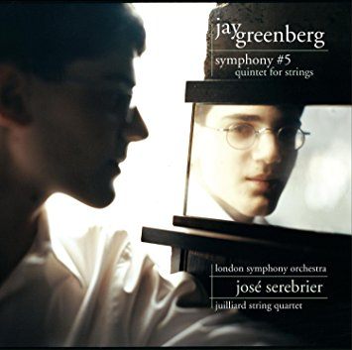
Examples – Creator/Contributor Characteristics
100 1_ Greenberg, Jay, $d 1991- $e composer.
240 10 Symphonies, $n no. 5
245 10 Symphony no. 5 ; $b Quintet for strings / $c Jay Greenberg.
__ New York, N.Y. : $b Sony Classical, $c ℗2006.
300 __ 1 audio disc : $b digital, SACD ; $c 4 3/4 in.
386 __ $3 Symphony no. 5 $i Composer: $a Teenagers $2 lcdgt
386 __ $3 Quintet for strings $i Composer: $a Preteens $2 lcdgt
386 __ $i Composer: $a Boys $2 lcdgt
__ $i Composer: $a Americans $2 lcdgt
650 _0 Symphonies.
650 _0 String quintets (Violins (2), viola, cellos (2))
650 _0 Music by child composers.
655 _7 Symphonies. $2 lcgft
655 _7 Chamber music. $2 lcgft
700 12 Greenberg, Jay, $d 1991- $t Quintets, $m violins (2), viola, cellos (2)
Notes:
The symphony was written when the composer was 13. The quintet when he was 12. The slide illustrates the use of subfields $3 and $i

Slide 157
Examples - Audience and Creator
100 1_ Lindgren, Astrid, $d 1907-2002, $e author.
240 10 Pippi Långstrump i Humlegården. $l English
245 10 Pippi Longstocking in the park / $c by Astrid Lindgren ;
with pictures by Ingrid Nyman.
385 __ Children $2 lcdgt
386 __ Swedes $2 lcdgt
386 __ Women $2 lcdgt
600 10 Longstocking, Pippi $v Juvenile fiction.
650 _0 Parks $v Juvenile fiction.
650 _0 Criminals $z Sweden $v Juvenile fiction.
650 _0 Girls $z Sweden $v Juvenile fiction.
651 _0 Sweden $v Juvenile fiction.
655 _7 Fiction. $2 lcgft
Notes:
Another individual work. In this example, the cataloger has chose to record the demographic group codes in subfield $n in addition to the LCDGT terms. Both audience (385) and creator/contributor characteristics (386) have been recorded. In this example the creator (Lindgren) and the contributor (Nyman) are both Swedish women. The translator (another contributor) is unnamed.

Slide 158
Examples – Audience and Creator
100 1_ Labrecque, Ellen, $e author.
245 14 The science of a triple axel / $c Ellen Labrecque.
385 __ Preteens $2 lcdgt
385 __ Fourth grade students $2 lcdgt
385 __ Fifth grade students $2 lcdgt
__ Sixth grade students $2 lcdgt
386 __ Pennsylvanians $2 lcdgt
386 __ Women $2 lcdgt
521 1_ 8-12.
521 2_ 4-6.
650 _0 Axel jump $v Juvenile literature.
650 _0 Figure skating $v Juvenile literature.
650 _0 Physics $v Juvenile literature.
650 _0 Sports sciences $v Juvenile literature.
Notes:
Although there is some meaning in overlap between the age group “Preteens” and the educational level groups recorded here, because the terms are from different categories, they can all be recorded.

Slide 159
Examples – Audience and Creator
130 0_ Young American (New York, N.Y.)
245 14 The young American.
__ New York : $b Frank Leslie, $c 1874-1876.
385 __ Teenagers $2 lcdgt
__ Americans $2 lcdgt
650 _0 Adventure stories, American $v Periodicals.
650 _0 American fiction $y 19th century $v Periodicals.
650 _0 Young adult fiction, American $v Periodicals.
655 _7 Action and adventure fiction. $2 lcgft
655 _7 Short stories. $2 lcgft
655 _7 Periodicals. $2 lcgft
Notes:
A serial for teenagers, written by Americans.

Slide 160
Facets and Your Discovery System
We have deconstructed LCSH into a number of facets, and we have other additional facets that describe works. Now what does your ILS do with all of it?
Possibilities:
Index everything for keyword
Provide facets for limiting
Provide browse searches

Slide 161
Notes:
A few examples of what is possible in discovery systems. Here we are in the University of Oregon Primo online catalog, and we start with a keyword search for the word “films”.

Slide 162
Notes:
ANIMATED SLIDE
On the left side of the screen, there is a genre/form facet that enables you to include or exclude particular genres.

Slide 163
Notes:
In this slide, I’ve done a keyword search for “novels” in the University of Washington Primo discovery system (sandbox version; you won’t yet see this in the publicly available catalog). There are facets for LCGFT (not shown in slide), Original Date, Original Language, Associated Place, Creator Demographic Group, and Audience, among others.
Second click: If you click “Show More” in the Creator Demographic Group box, you get a larger list of choices.

Slide 164
Notes:
After selecting the demographic group “African Americans” to filter the search results, you get a screen such as this one. Let’s now click on the second title in the list of results (Harlem Renaissance)…

Slide 165
Notes:
The entire record is not shown in this slide, but you can see that genre/forms assigned are displayed and clickable, and work information recorded in various fields (dates of the works in the collection and creator demographic groups) are shown in the item details part of the display.

Slide 166
Notes:
ANIMATED SLIDE
Brigham Young University is the only other library that I’m aware of that is displaying LCDGT audience and creator/contributor terms. The terms are also keyword indexed for searching. No limiting facets yet, however.

Slide 167
Finally - What About All Our Old Records?
In order for faceted vocabularies to work best, we will need to figure out how to add facets to legacy records. Think about how many literature and music records don’t have any genre/form terms in them. Audience and creator/contributor terms would also be helpful.
ALCTS CaMMS Subject Analysis Committee has issued a white paper: A Brave New (Faceted) World: Towards Full Implementation of Library of Congress Faceted Vocabularies (http://hdl.handle.net/11213/8146)

Slide 168
A Brave New (Faceted) World
Key Points:
need critical mass of bibliographic metadata that includes these faceted attributes
full-scale implementation requires a combination of broad and comprehensive training of catalogers (“current implementation”) and retrospective implementation through the development of nuanced and powerful machine algorithms
requires buy-in and support of national and international entities like PCC, LC, OCLC and library systems vendors
addition of genre/form terms should be a core requirement for PCC records
strongly encourage the addition of 382 fields, using LCMPT terms whenever appropriate
add LCDGT to both bibliographic and authority records, until authority records are created for all personal names and works and expressions; then just add to authority records
shows how retrospective enhancement of records could be achieved based on fixed field values and codes, LCSH and classification numbers, and other data already in records

Slide 169
Thank you!

